Slide 1

Transforming Corporate Learning
A N Rao
SVP & Global Head : Cognizant Academy

Slide 2




The mighty have fallen through-out human history and its not just a history lesson

Slide 3
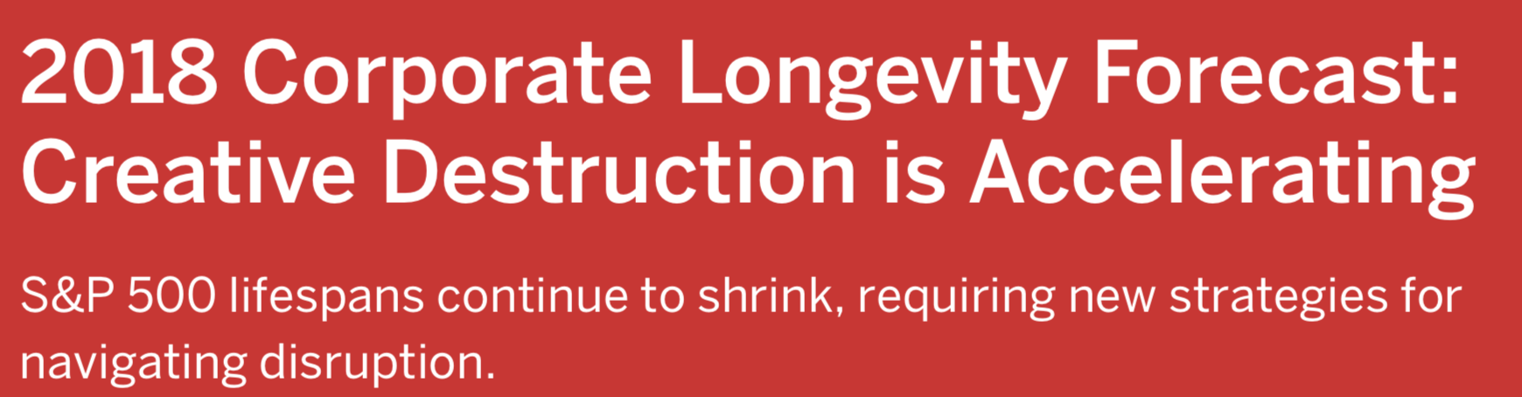
The 33-year average tenure of companies on the S&P 500 in 1964 narrowed to 24 years by 2016 and is forecast to shrink to just 12 years by 2027
Innosight report By Scott D. Anthony, S. Patrick Viguerie, Evan I. Schwartz, and John Van Landeghem

Slide 4
Digital for a majority still is …
Building Blocks
Intermediate Products
OR
Additive
Manufacturing
Augmented
Reality
Automation, AI
Autonomous
Platform
Economy
IoT
Ecosystems
Blockchain

Slide 5
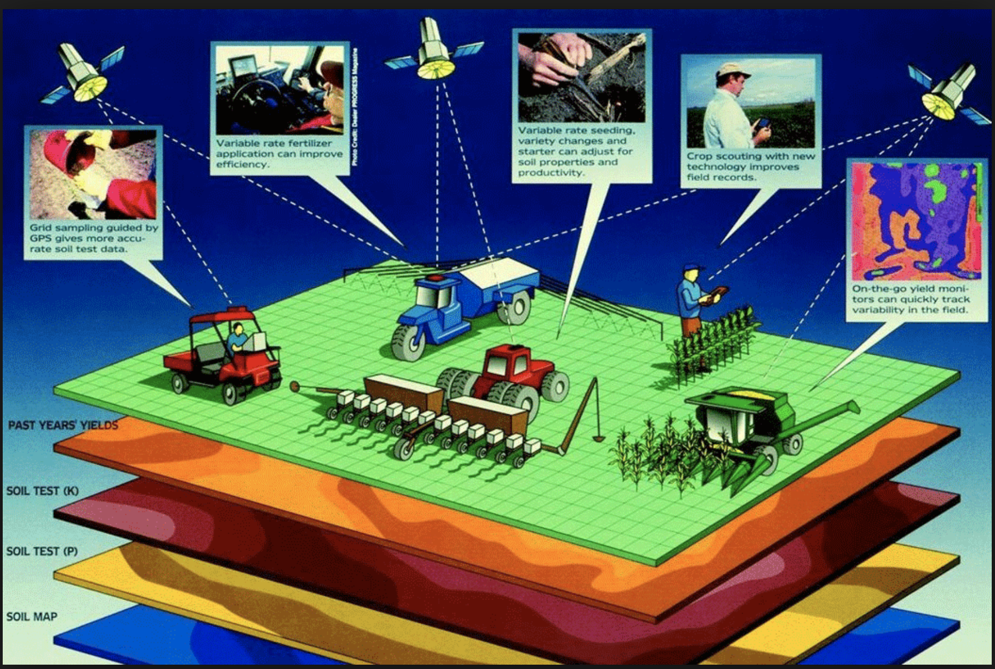
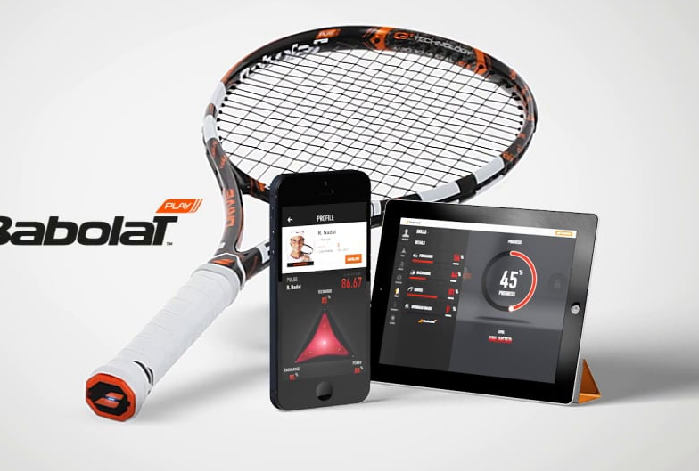

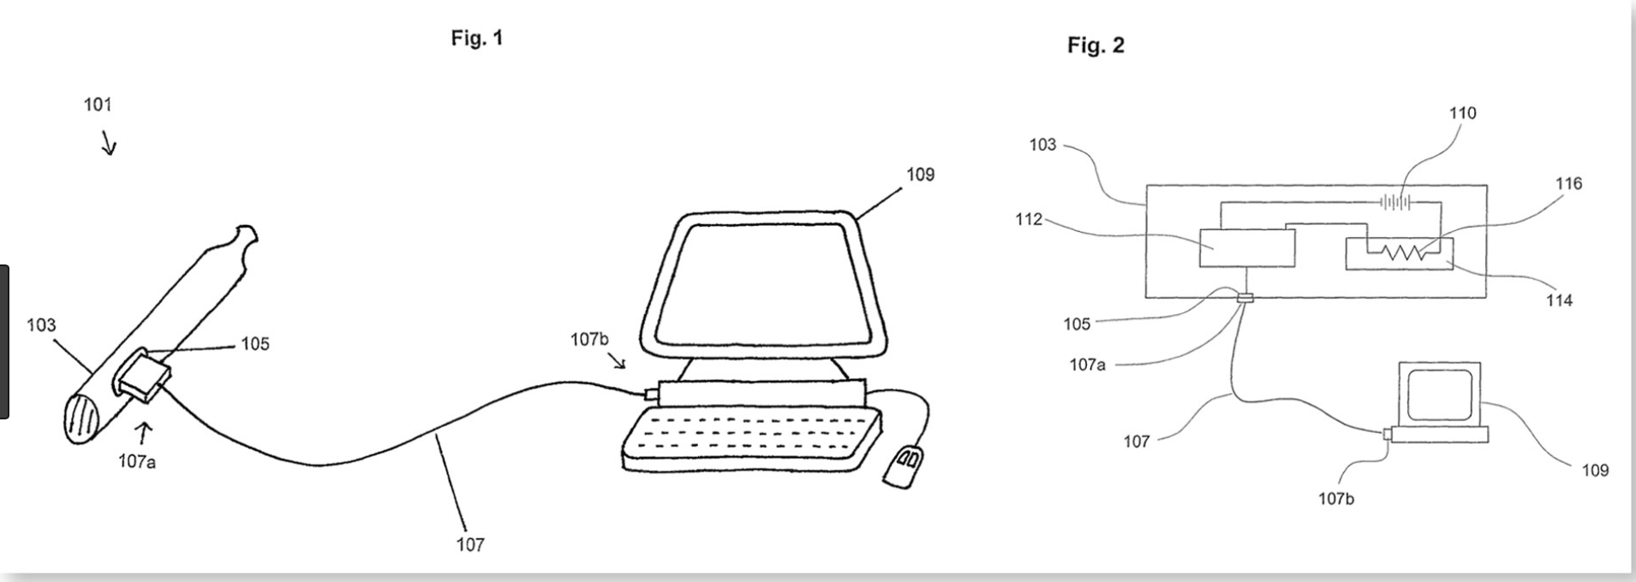
But life (in the Digital world) moved on
Notes:
Philip Morris’s smart cigarette that tracks your smoking patterns, Rafa’s smart racquet from Babolet, Proteus’s smart chip the size of a grain of sand or the mighty precious agriculture .. Its all about impact and that is a huge change for the industry

Slide 6
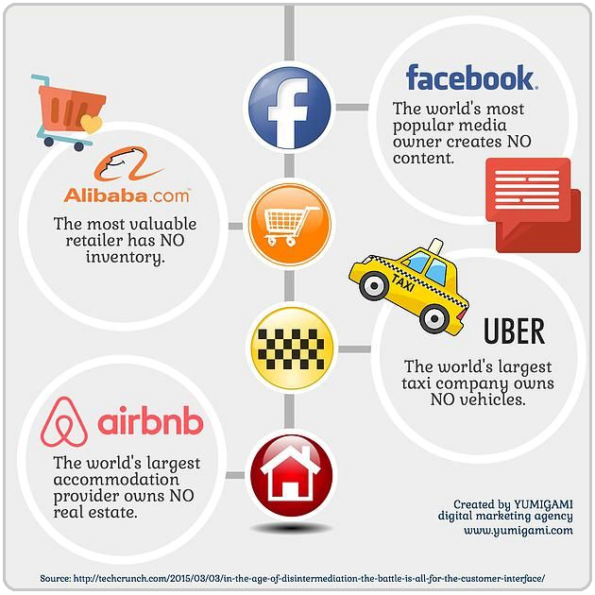
There are the Digital Disruptors

Slide 7
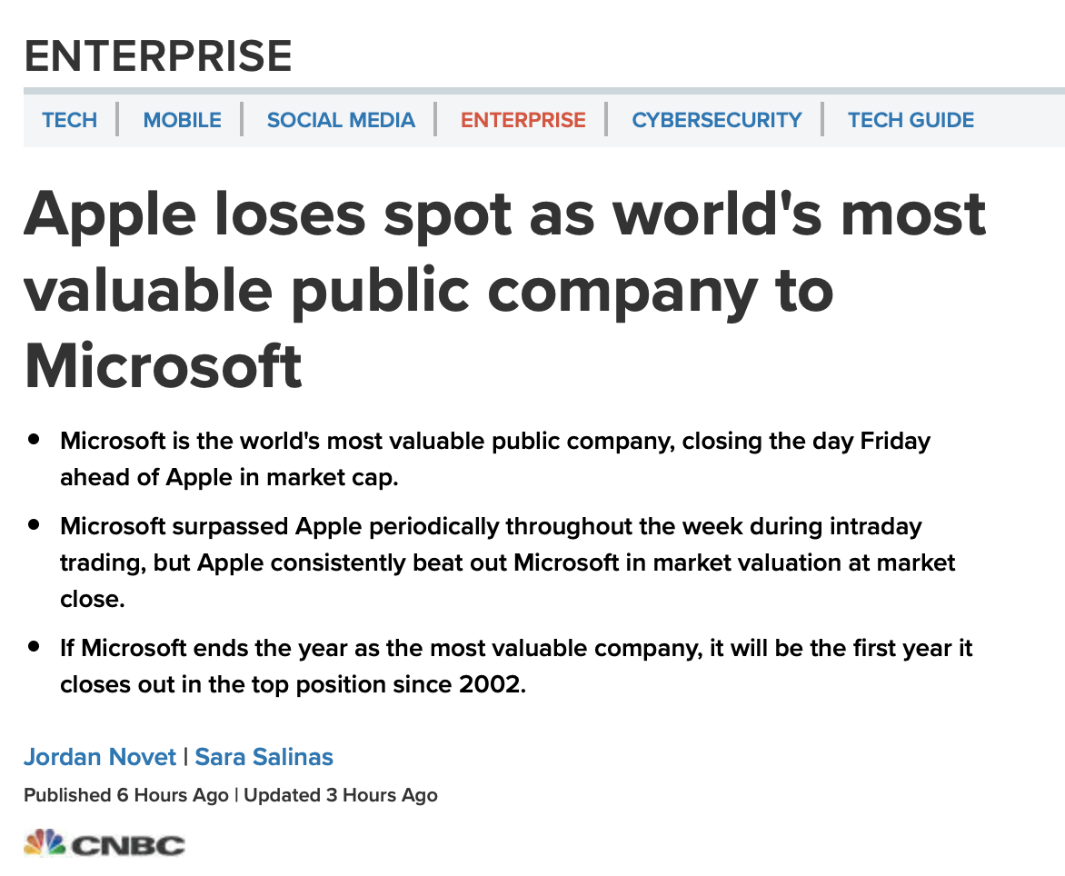
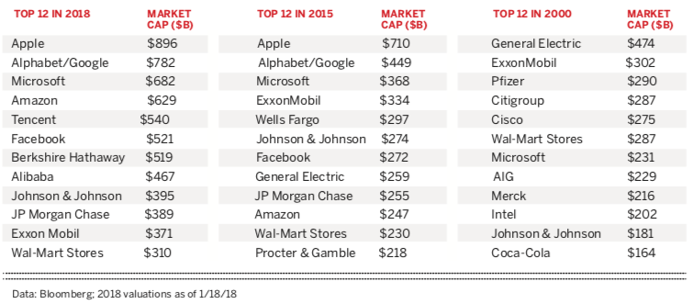

And There are others …. Who made the move and changed rapidly

Slide 8
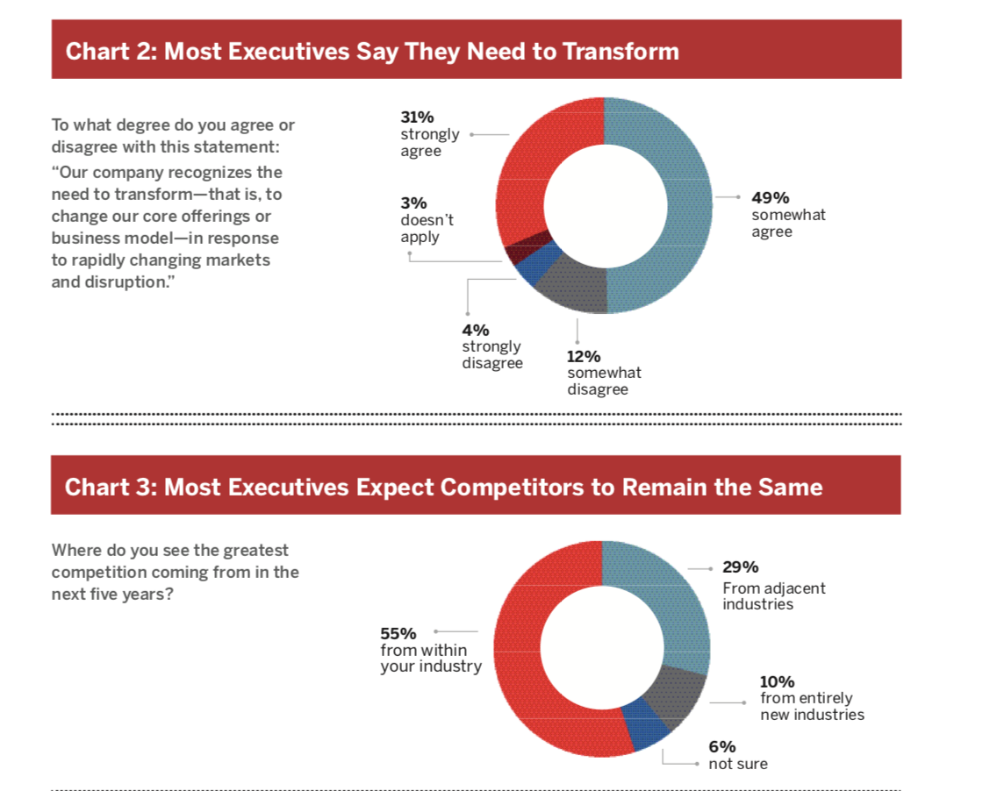
The others get it but don’t yet get it fully
Most executives say they know they need to transform
And there are those
Who still don’t get it
Stuck in a “Confidence Bubble”
But most expect the competitors to remain the same

Slide 9
If the writing on the wall is so clear, and the reward is survival, why is it being so hard to change?
Innosight report By Scott D. Anthony, S. Patrick Viguerie, Evan I. Schwartz, and John Van Landeghem

Slide 10
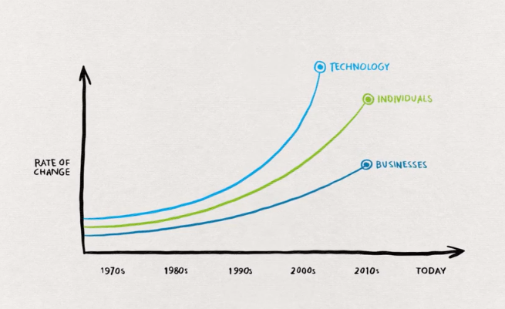
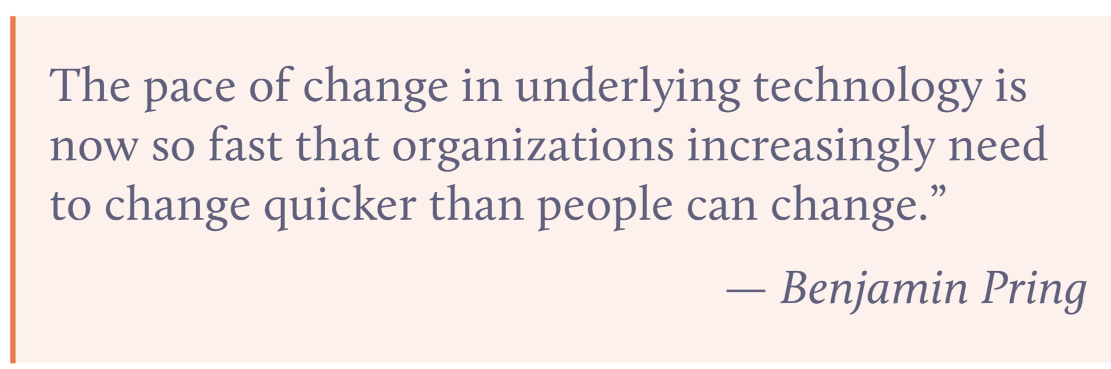
The reality of the multi-lane movement they miss…
DeLoitte industry 4.0 readiness report

Slide 11
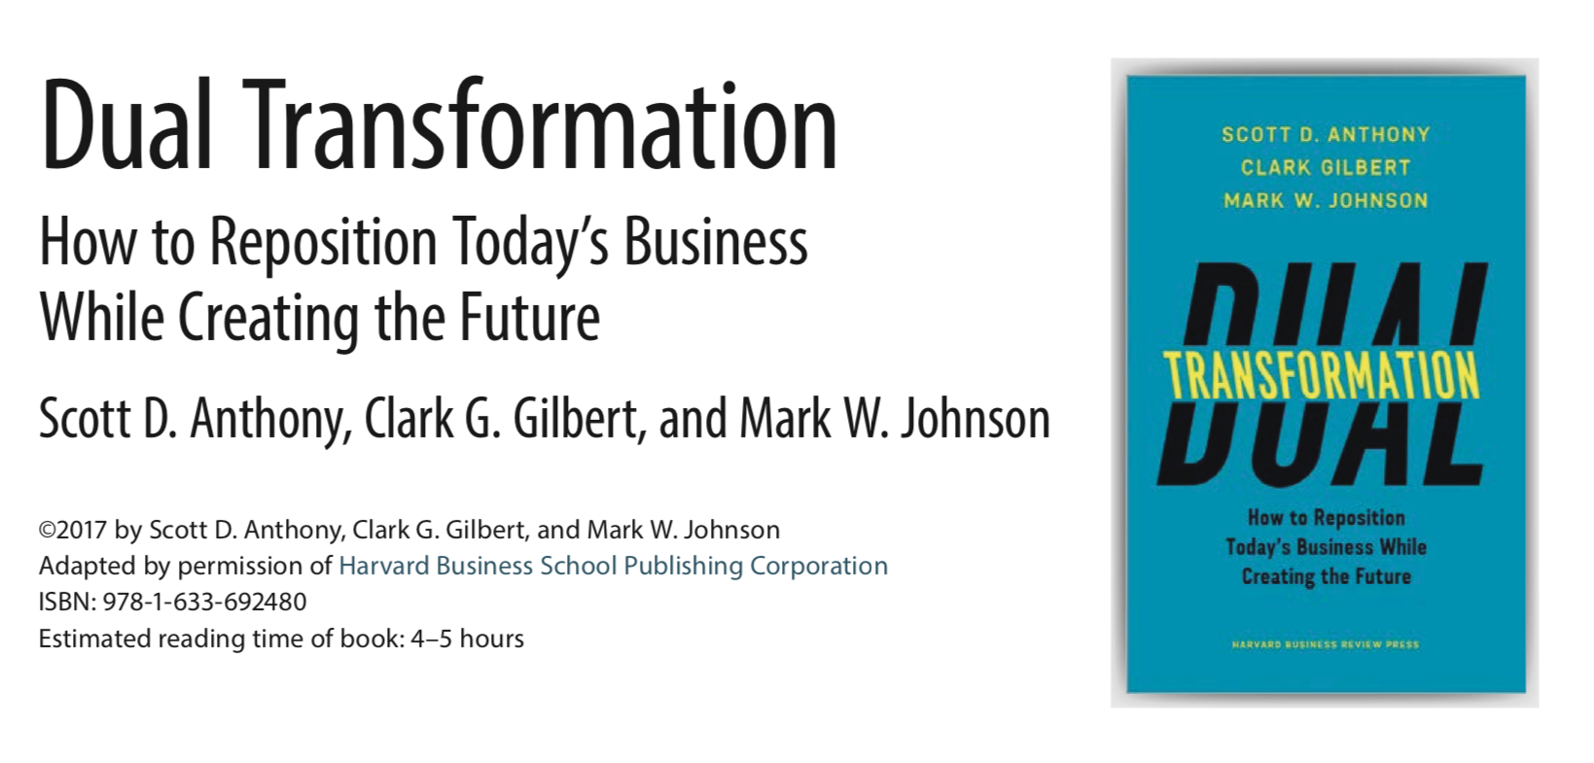
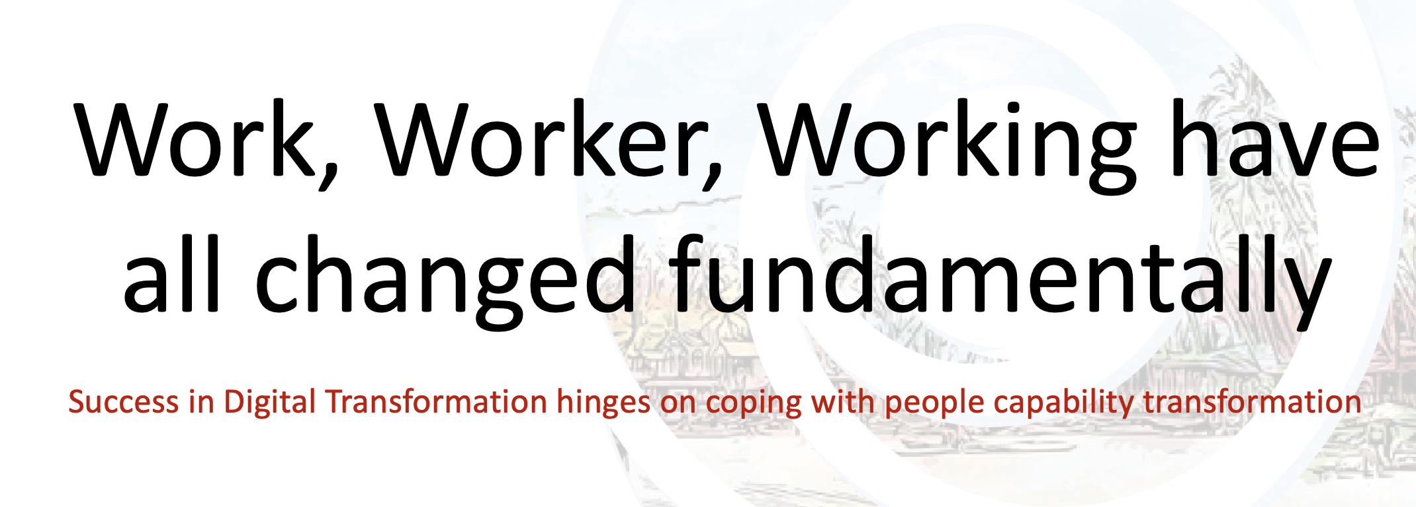
The survivors are ambidextrous leaders
The Dual Transformation Strategy
The Talent Transformation Strategy

Slide 12
Work, Worker, Working have all changed fundamentally
Success in Digital Transformation hinges on coping with people capability transformation

Slide 13
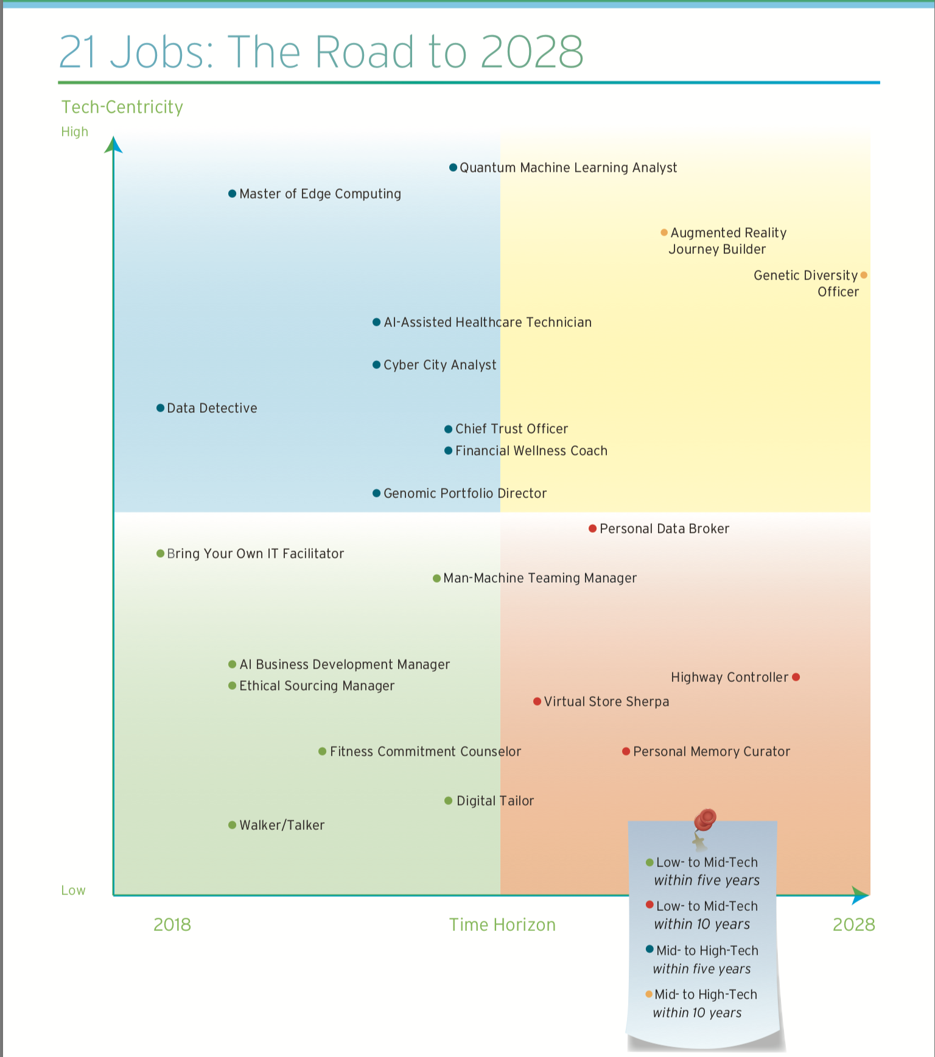
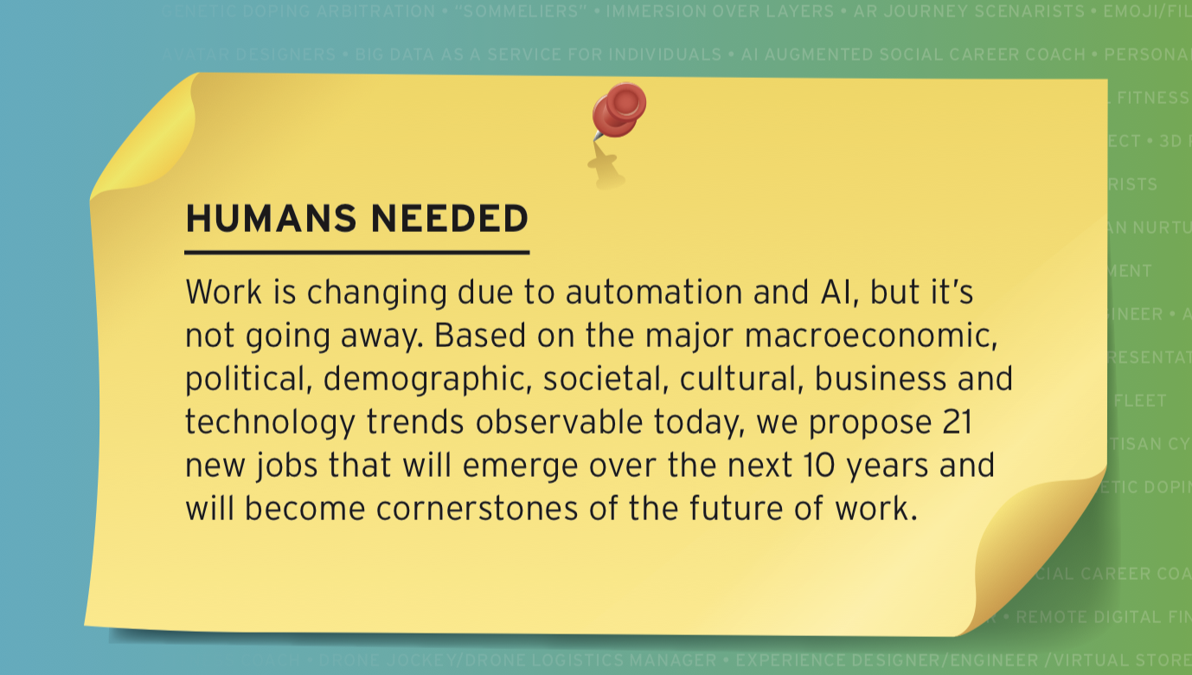

Work has changed

Slide 14
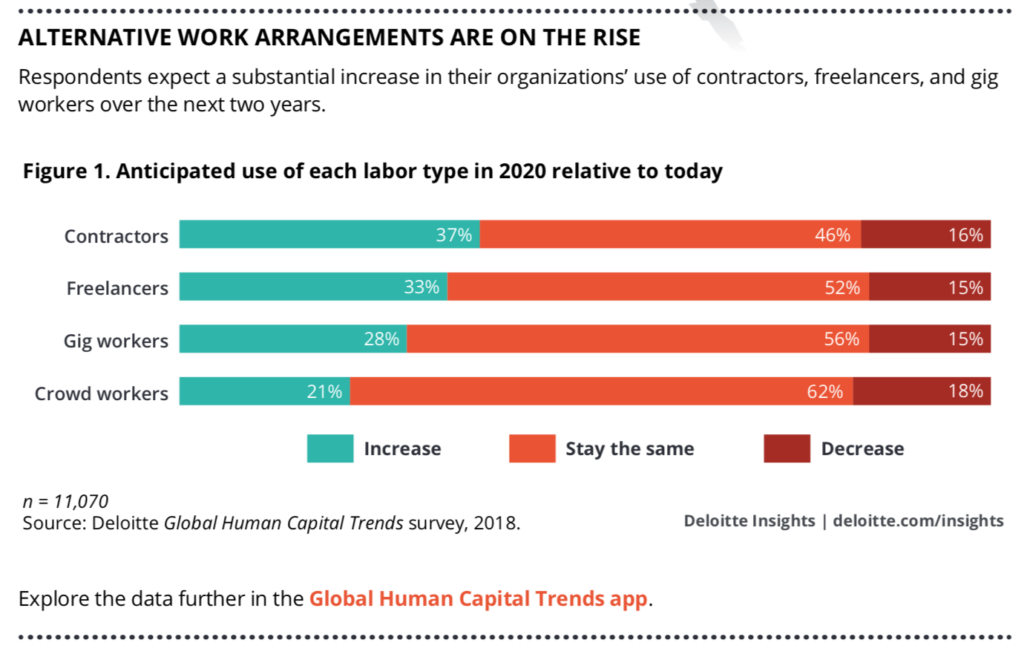

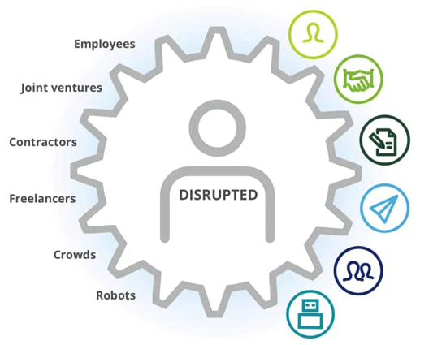
Worker has changed ....
Images courtesy : DeLoitte

Slide 15
Survivor Corporations respond differently to
The Digital Stimulus
Learning Agility is the ONLY sustainable competitive differentiator and survival mantra
Build a Digital Ready Work Force that is continuously future ready

Slide 16
But, “Goa we have a problem ..”
CORPORATE
LEARNING
FUNCTIONS

Slide 17
But, There is Good news is
We see exponential transformation of corporate learning over the past 2-3 years
Innosight report By Scott D. Anthony, S. Patrick Viguerie, Evan I. Schwartz, and John Van Landeghem

Slide 18
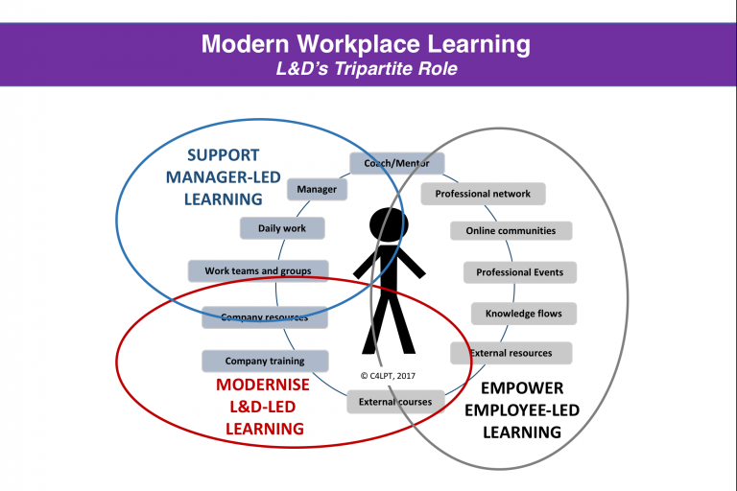
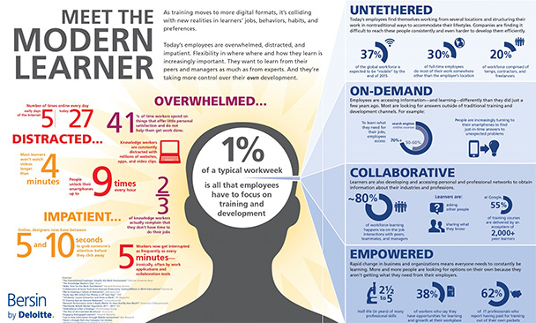
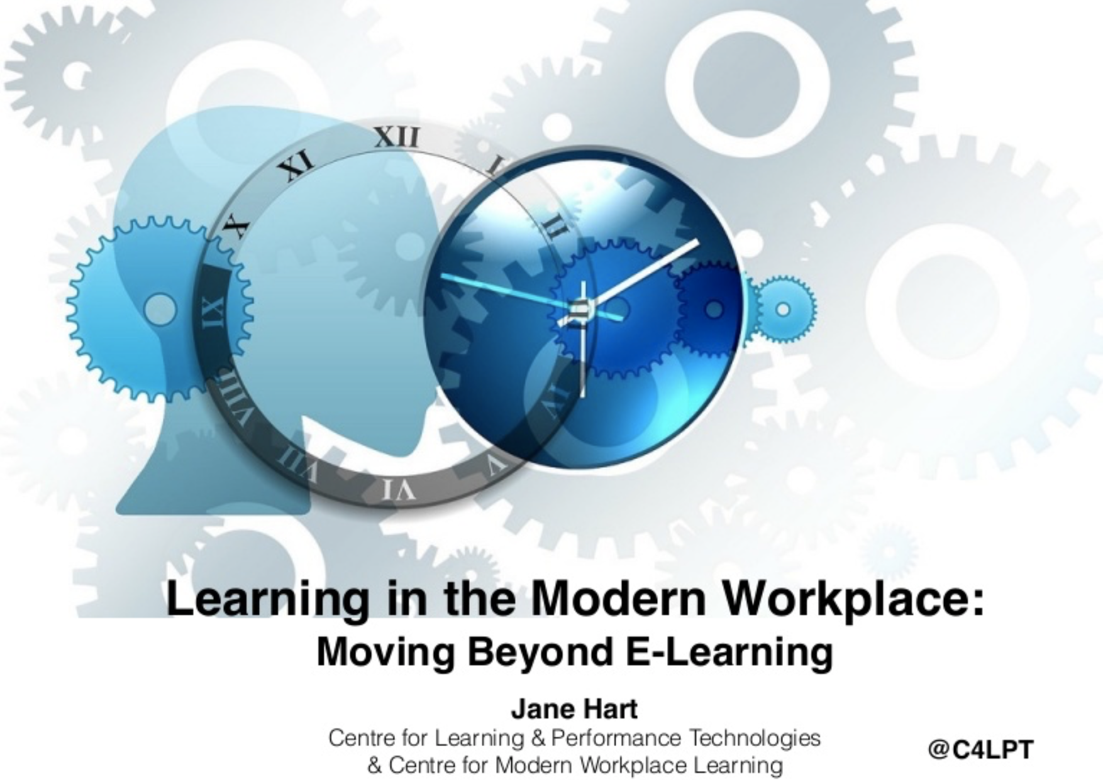
Heralding the age of rapid acknowledgement
And exponential change in corporate learning

Slide 19
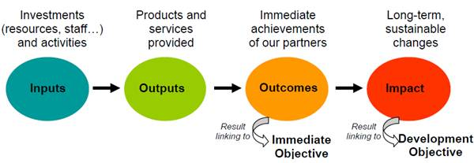
Input to Impact

Slide 20
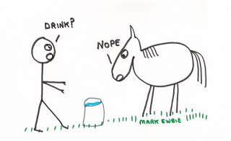
Take ownership : it’s a horse, not a donkey
The much maligned horse

Slide 21
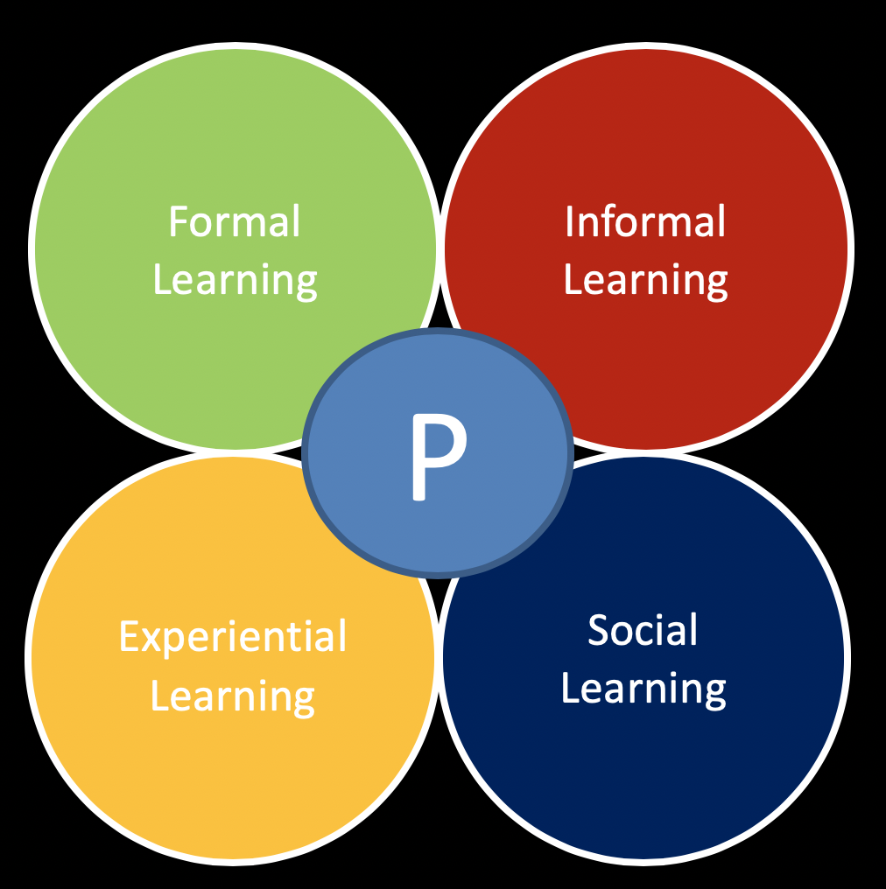
Mindset of the new CLO

Slide 22
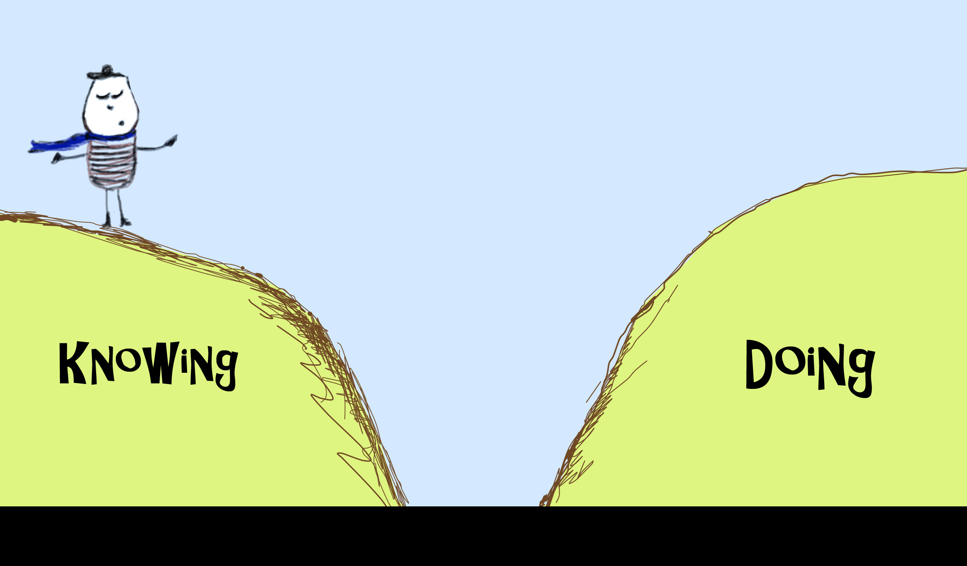

CLO’s Manufacturer’s warranty
Notes:
On completion of training, pilots can fly- chefs can cook – surgeons can perform surgery – corporate learners ask for learning curve and ‘on the job learning’

Slide 23
The “death of the learning curve paradigm”
Meteoric rise in Project Complexity
Y2K to Digital Transformation
Gamification
Simulation
Hackathons
Continuous - …. Assessment
Customer expects least time spent in Training
8 months to 8 days
1995
2017
C, C++, COBOL, Java
Rapid influx of New Technologies - 4 to 40+ tech in last 15 years
where Graduates can be deployed

Slide 24
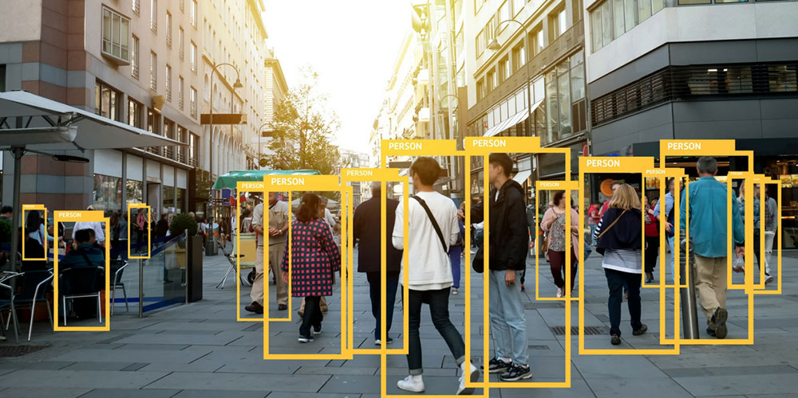
N=1 (Hyper Personalization)
Notes:
Days of throwing 30 learners in a class room and assuming they will alllearn with the same inputs are gone ….. Each learner has a different learnability, learning ability, learning preference, span of attention and a choice of read – listen – watch - do

Slide 25
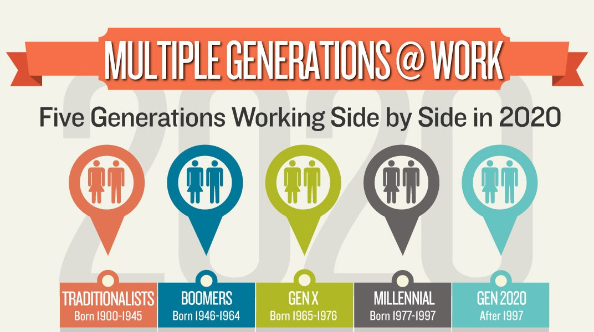
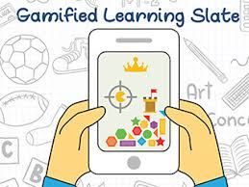



Gen A : 5 generations with one learning imperative

Slide 26
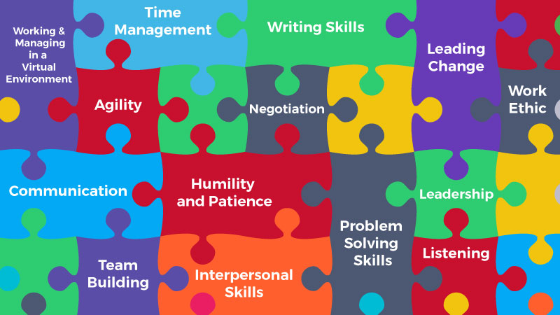
Soft skills are today’s hard skills
Image courtesy : edupristine.com

Slide 27
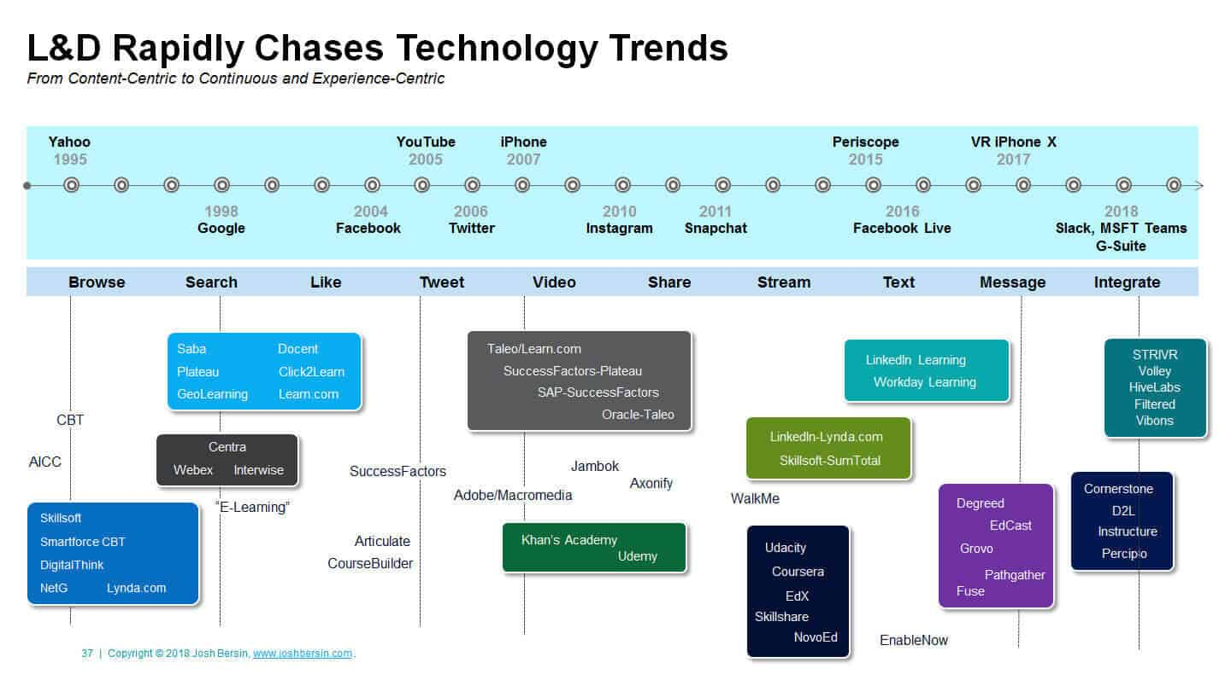
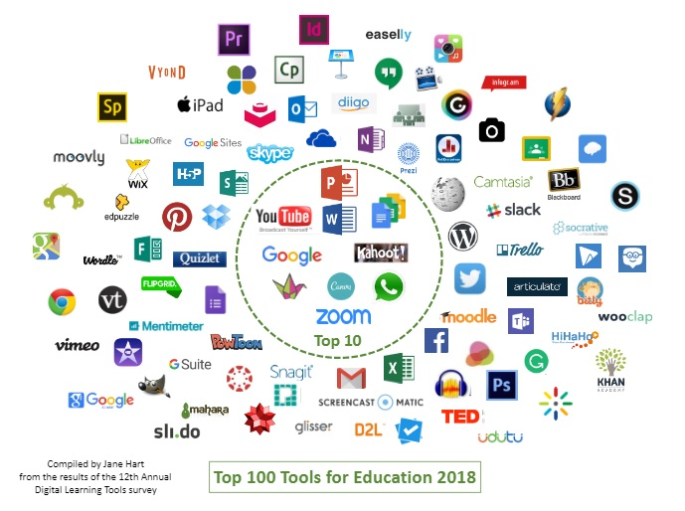
Technology to scale and personalize experience
Infographic Courtesy : josh bersin

Slide 28
In Summing up
Organizational survival is not assured
Dual strategy of reimagining the corporation and rethinking learning
Corporate learning old ways have been the dampener
Exponential transformation visible in the CLO world is the hope
We are the fuel, not the ballast
Notes:
On completion of training, pilots can fly- chefs can cook – surgeons can perform surgery – corporate learners ask for learning curve and ‘on the job learning’

Slide 29



