Slide 1
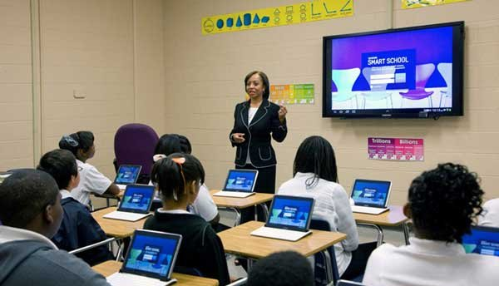



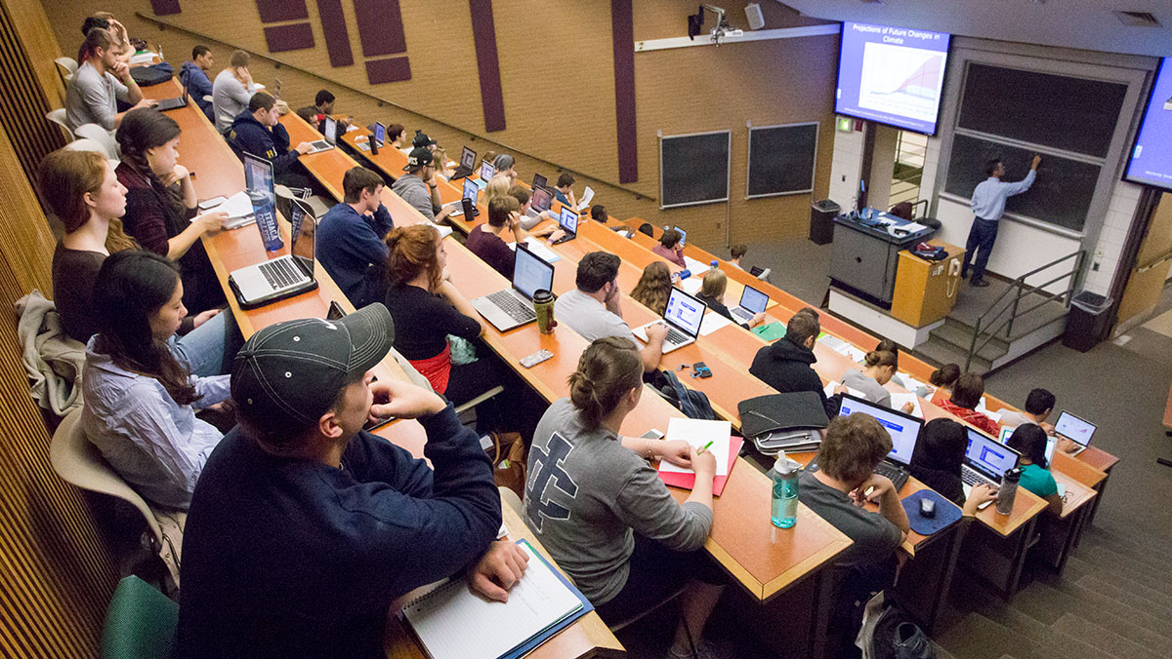
ISB – Digital Learning Eco System
Learning @ ISB is a blend of Class room Teaching & new generation Digital Technologies
Antarpreet Singh
Director – Digital Learning
Version 1.2, Dec 06, 2018

Slide 2
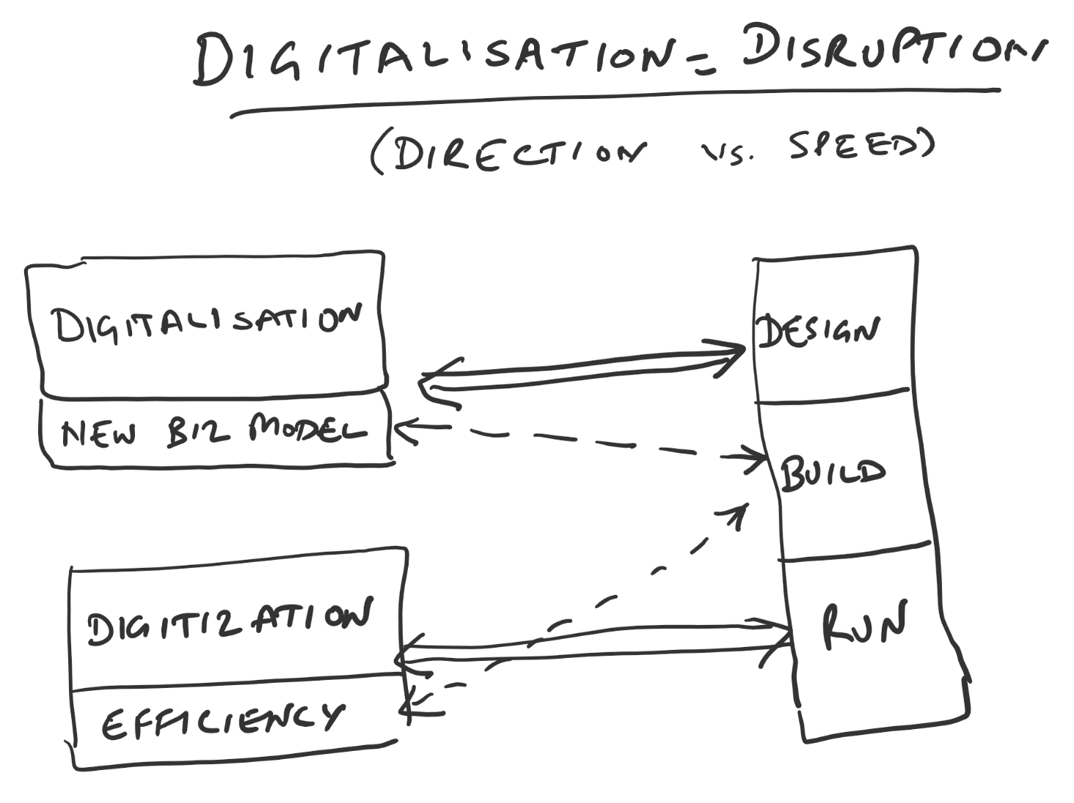
ISB – Disrupting ExEd space thru Digitalisation
70%
20%
10%

Slide 3
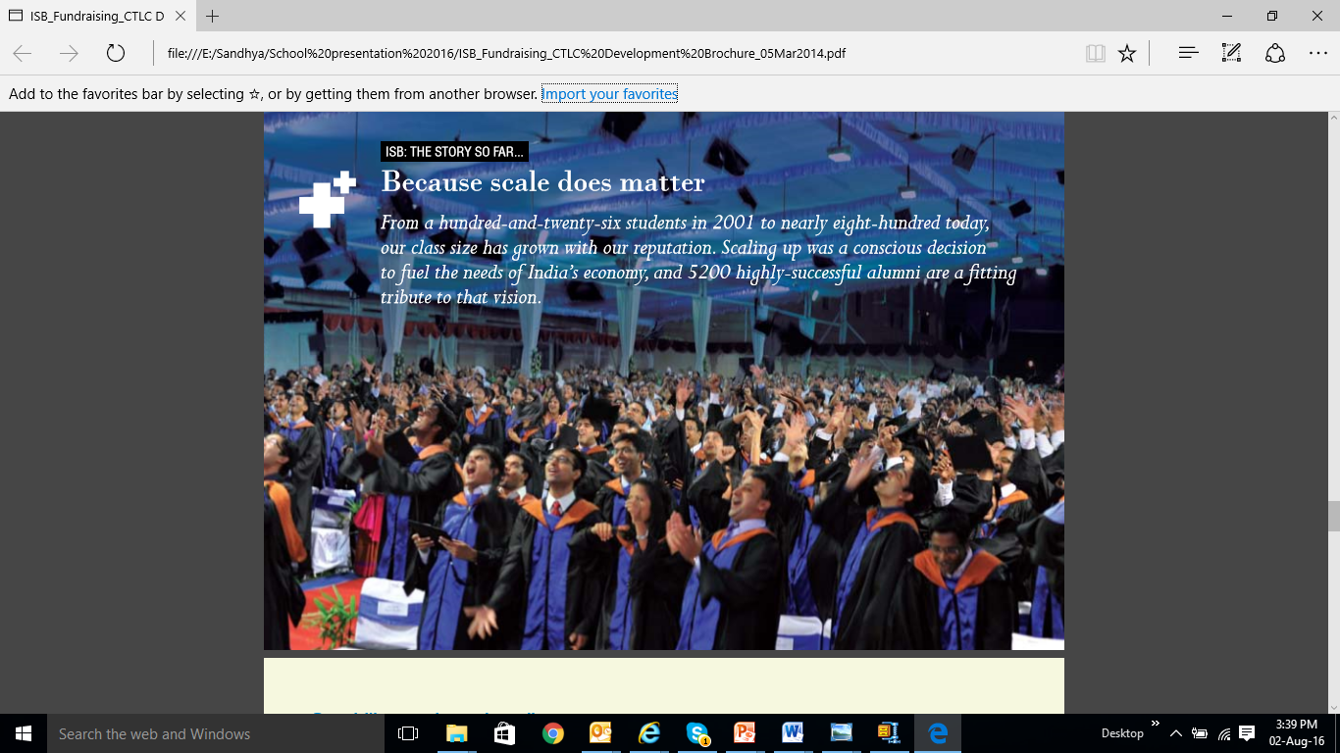





PGP suite + Executive Education
ISB – Global management education eco system
45,000 Executive Education Participants
(Approximately 5,000 per year)

Slide 4


























ISB – Global Faculty model (top B-Schools)
51 Residential Faculty
&
150 Visiting faculty teach at ISB from the best B-Schools in the world
Precursor to ➔

Slide 5
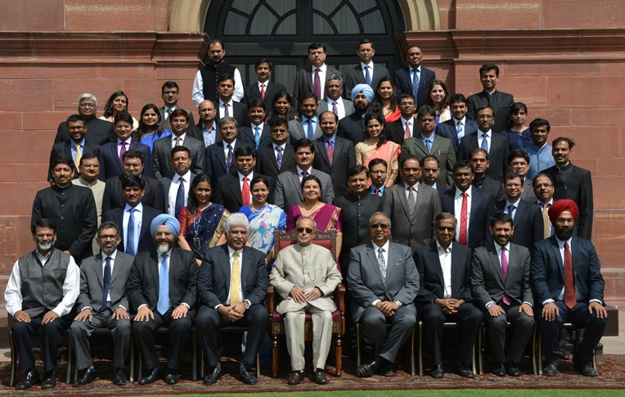
Certificate Programmes in Areas of National Importance
Healthcare Manufacturing Public Policy Infrastructure Analytics
Public Policy: with Fletcher School of Law and Diplomacy (Tufts University) delivers a one year custom made programme for developing skills relevant for understanding the challenges of public policy and its implementation.
Healthcare: with Wharton
Creation of a generation of healthcare managers and leaders.
Manufacturing: with MIT Sloan
To strengthen the 'Make in India' campaign by imparting global tools to managers of manufacturing companies
Infrastructure:
To develop leaders with understanding of the multidisciplinary challenges of the sector & drive the nation into the future
Business Analytics:
To hone analytical skills to generate actionable business insights

Slide 6

Digital Learning @ ISB extended eco system
ExEd
Blended Learning
- Synchronus (F2F, Virtual classroom)
- Self Learning
New Generation Media labs – Digital Studios
Digital Content Store – linking all content repositories
Unified Core platform (Digital Campus)
Univs / B & T schools
AMPs
PGP
Suite
ISB Academy
World’s largest PGP suite
4 world class Institutes for Adv. Mgt. programs (AMPs)
India’s top rated Business Analytics certification program
World class Executive education eco system
ISB academy for Faculty & Staff for continuous learning

Slide 7

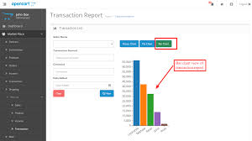
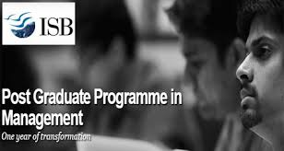







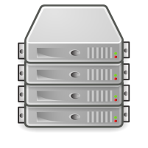





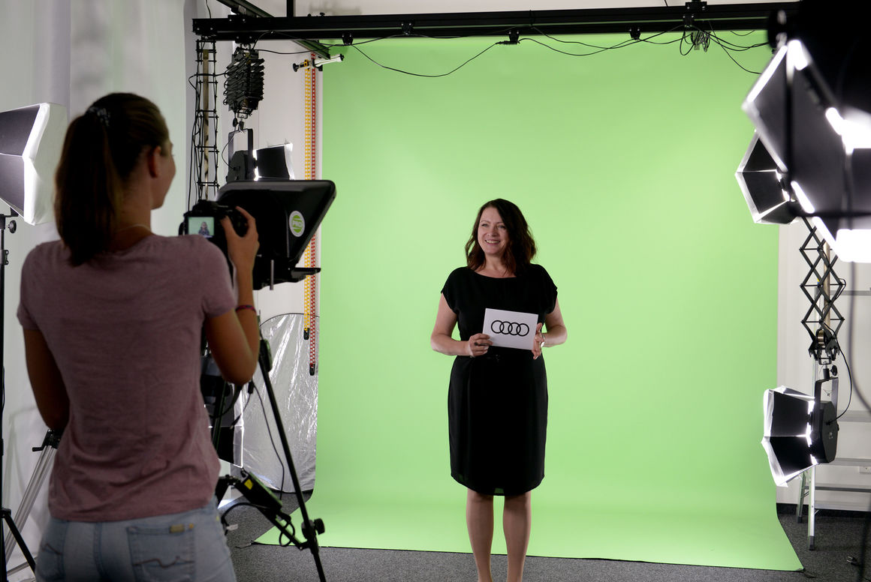

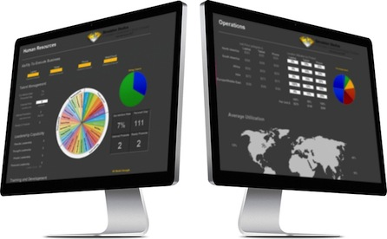

ISB Digital Campus (Global reach)
Immersive Digital Learning Experience
ISB Cloud Infrastructure
Faculty
Learning
Operations
Secure and Cost optimized
Public
Network
Web Server(s)
Internet
Private Network
Storage
Database Server(s)
Computing  Storage  Auto Scaling  High Availability  Performance
Simulations +
Case Studies
*This diagram is for illustrative purpose only.
Digital Studios
EdTech Labs

