Slide 1
PUTTING PEOPLE AT THE CENTRE OF DIGITAL TRANSFORMATION
Building Talent as a competitive edge for India
Debjani Ghosh
President, NASSCOM

Slide 2









TOP 5 COMPANIES by Market Capitalization
2008
70% of leaders in all sectors may be disrupted in the next 10 years… Tech Disruption at Work!
US$ 492 bn.
US$ 358 bn.
US$ 313 bn.
US$ 238 bn.
US$ 226 bn.
Tech/IT Company
Non-Tech Company
2018
US$ 890 bn.
US$ 768 bn.
US$ 680 bn.
US$ 592 bn.
US$ 545 bn.
Tech/IT Company
Non-Tech Company

Slide 3

Digital Transformation is profoundly reshaping the boundaries of competition…

Slide 4
Key Shifts Reshaping Businesses
Product/ Services Centric Business Model to Experience First
1
2
From Consumption to Co-Creation/Collaborative Economy
Closed Innovation to Open Innovation /Strategic Partnerships
3
4
Value based on Trust, Experience, Scale….
5
Pace of Change

Slide 5
The DNA of Successful Companies
Digital Mastery
Digital Capabilities
Digital Vision, Culture and TALENT
Loss | Profit
Loss | Profit
Low
High
The HOW
Digital Capabilities
The WHAT
High
Low
Digital Culture, Talent and Leadership
Source: MIT Sloan Management Review

Slide 6
Vision, Culture and Talent turns Digital Capabilities into Digital Advantage

Slide 7
The Digital Opportunity
Global digital transformation market is expected to grow from US$ 445.4 Bn in 2017 to US$ 2,279.4 Bn by 2025 at a CAGR of 24.3% between 2018 and 2025.
Report Buyer
https://www.prnewswire.com/news-releases/global-digital-transformation-market-is-expected-to-grow-from-us-445-4-bn-in-2017-to-us-2-279-4-bn-by-2025-at-a-cagr-of-24-3-between-2018-and-2025--300705888.html
The Risk….
By 2022, no less than 54% of all employees will require significant re- and upskilling.
Talent is the New Competitive Advantage of Companies and Nations..

Slide 8
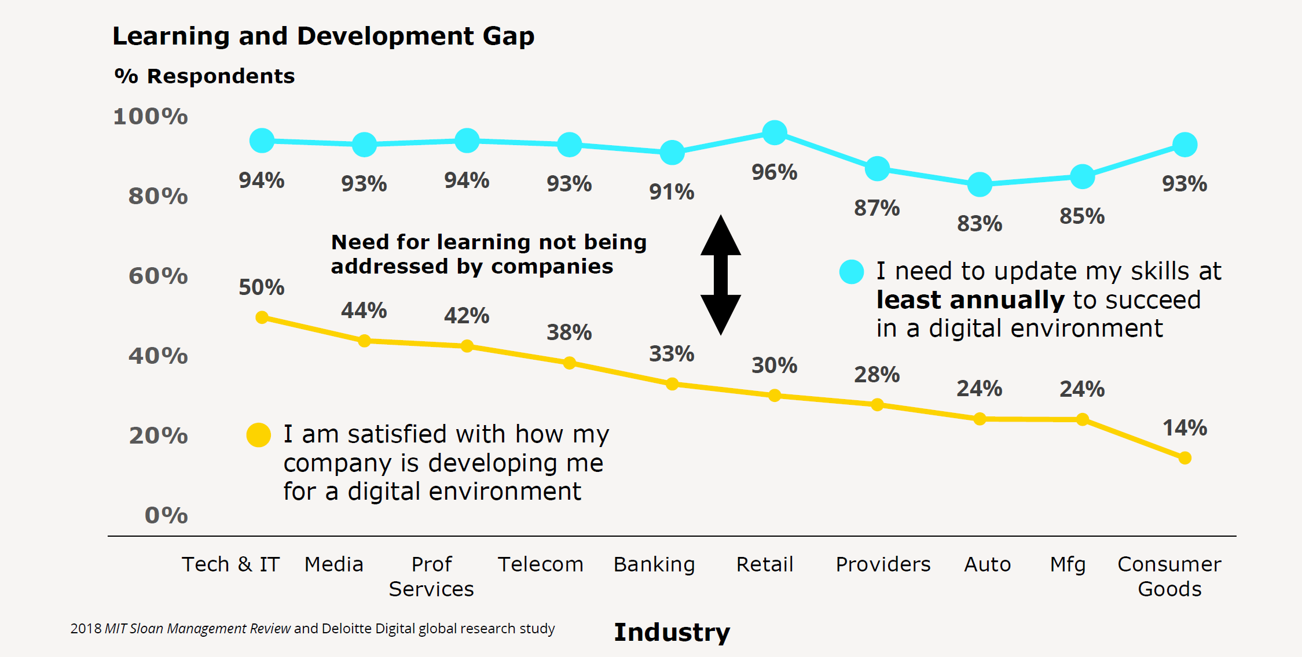
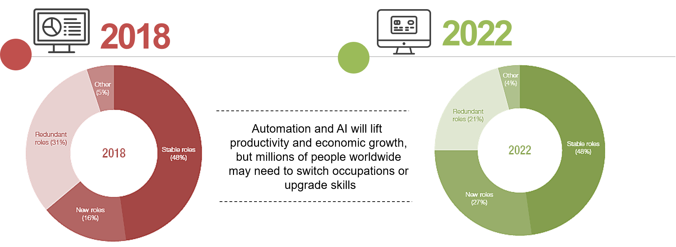
The Skill Challenge…
75 million jobs may be displaced in the global workforce, while 133 million additional new roles may emerge concurrently
Source: Future of Jobs Survey 2018, World Economic Forum.

Slide 9
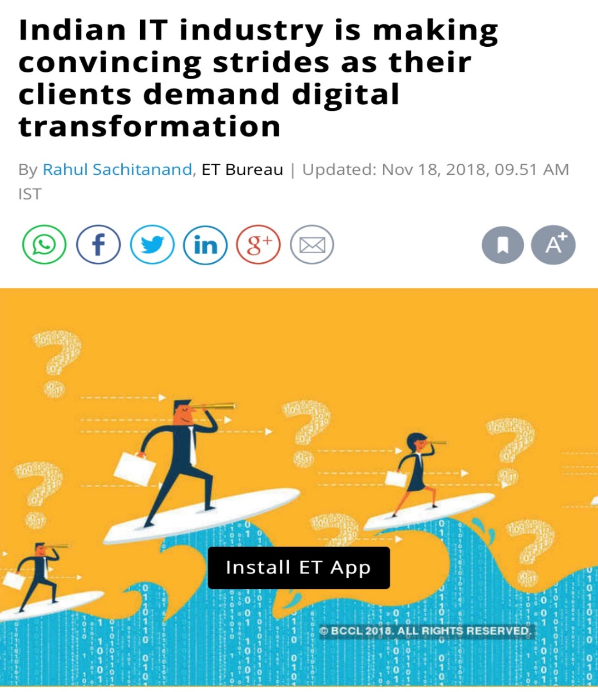

The Industry Response
Companies in India are looking at 3 key strategies of skilling/upskilling to deal with digital transformation:
~Rs10,000 Crores Investment on Skilling & Devlpt – IT Industry
Source: Future of Jobs Survey 2018, World Economic Forum.

Slide 10

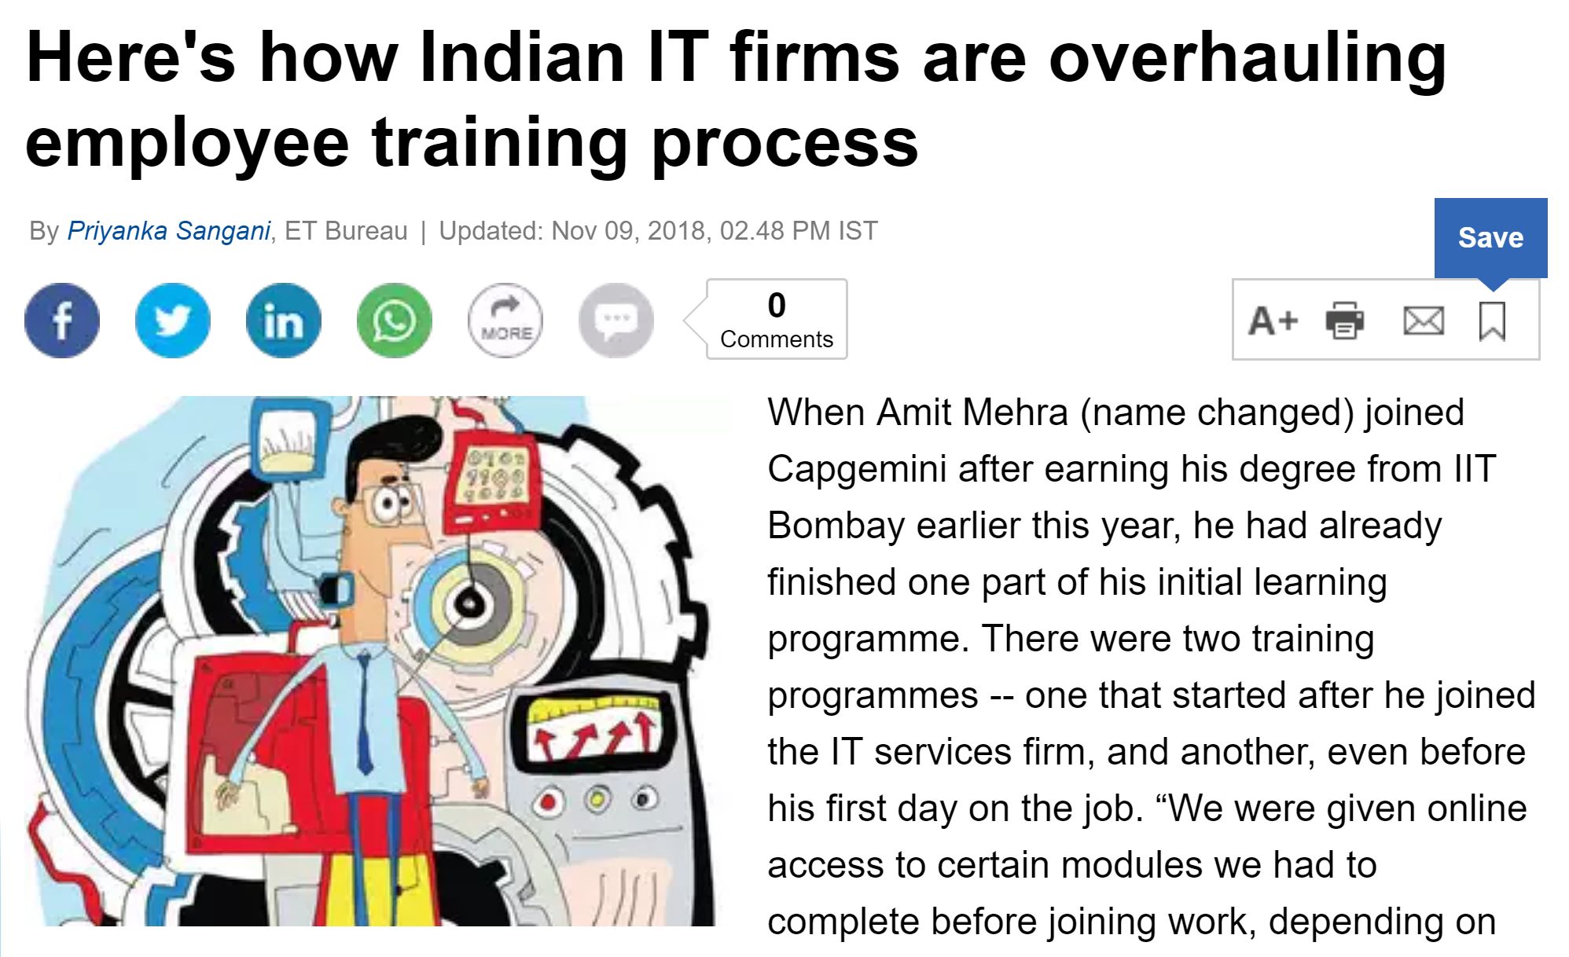
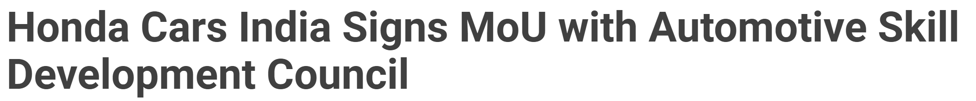
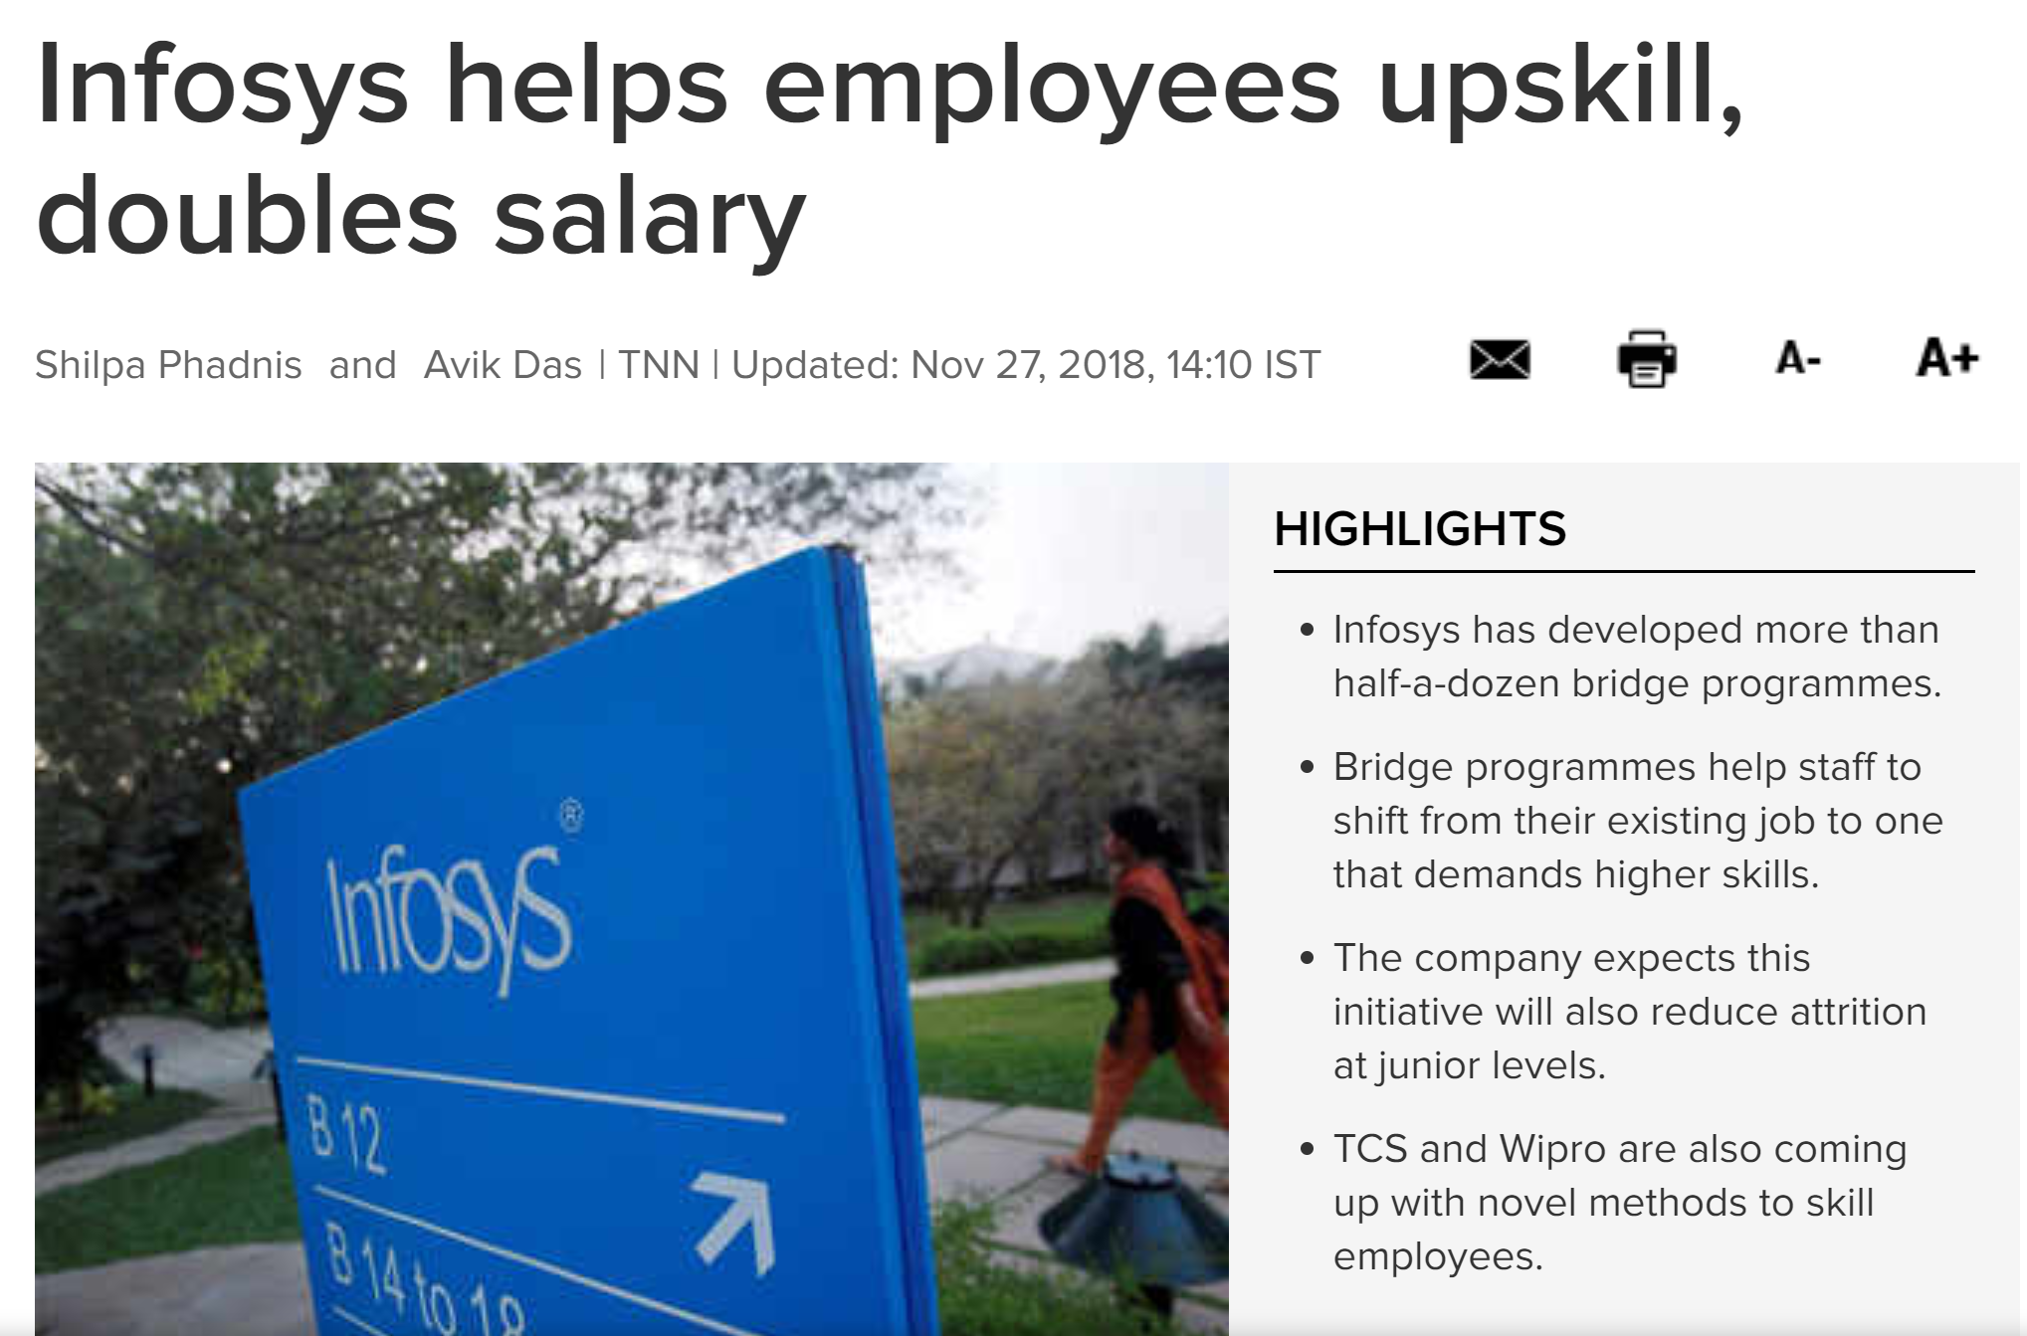
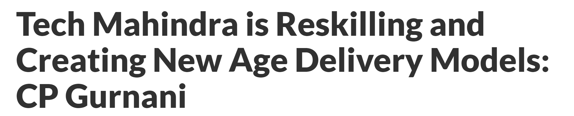

Slide 11
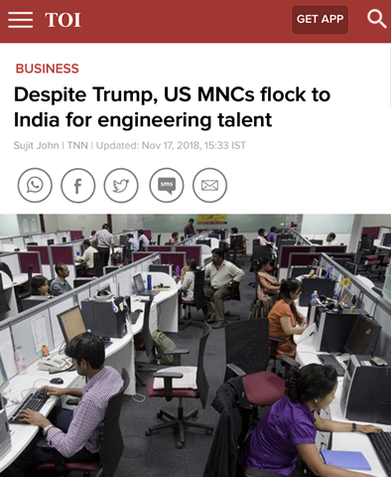


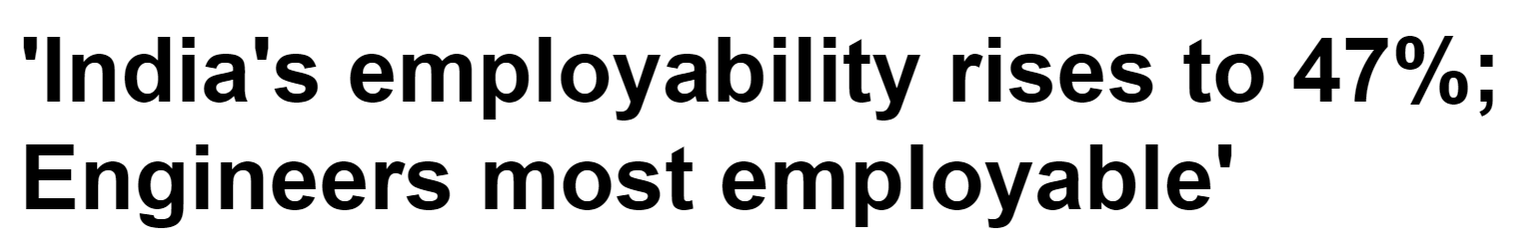
India Skills Report 2018

Slide 12
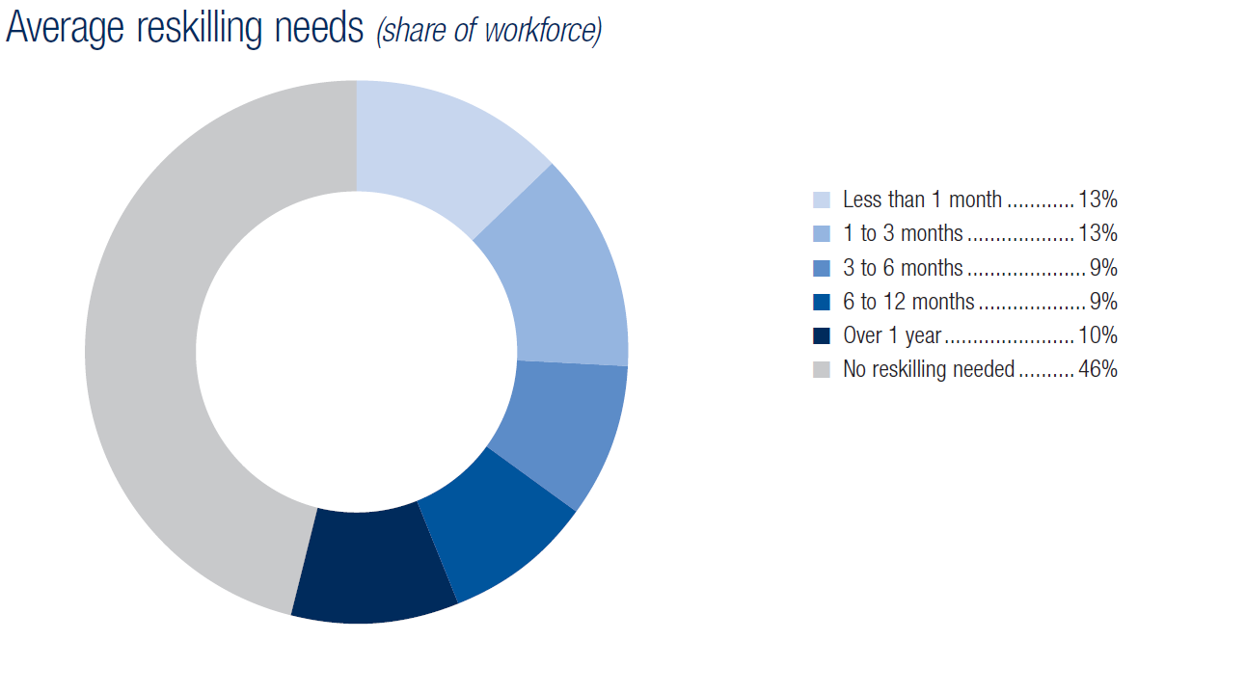
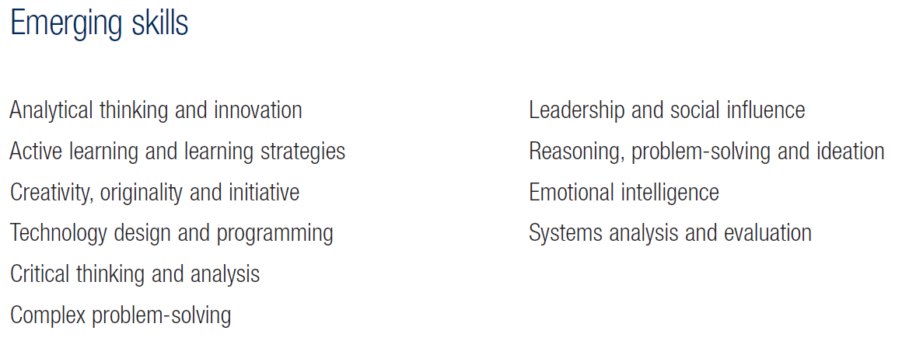
Is It Enough?
Source: Future of Jobs Survey 2018, World Economic Forum – India Data
Time for Another “Coalition of Competitors”
Notes:
It is crucial to think of a job creations strategy along with a growth strategy.

Slide 13
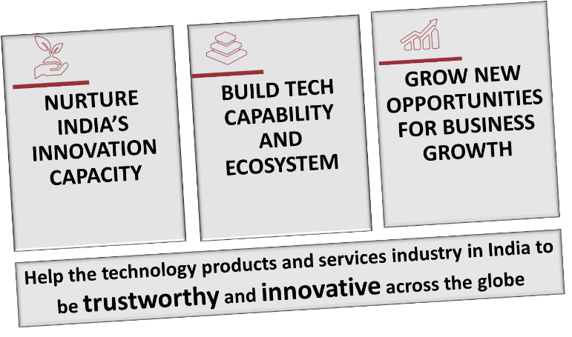


NASSCOM STRATEGIC IMPERATIVES… catalyzing industry transformation with focus on:
Job #1
An industry driven learning ecosystem to get India accelerated on the journey to building skills and becoming the global hub for talent in the emerging technologies.

Slide 14
FUTURESKILLS: An Industry Response, Catalyzed by NASSCOM
1
Goal
Discovery → Continuous Learning → Deep Skilling
FutureSkills
An industry driven learning ecosystem to get India accelerated on the journey to building skills and becoming the global talent hub in the emerging technologies.
Objective
Re-skill/ up-skill a total of about 2 million employees over a period of 5 years
10-70-155
10 emerging technologies, 70+ Job Roles, 155+ Skills
2
3
4
Emerging Job Roles
Job roles coming into existence, evolution of the existing roles. From Cyber Security to Analyst Application Security
Big Data Analytics
Artificial Intelligence
Cyber Security
Robotic Process Automation
Internet of Things
Mobile Tech
Cloud Computing
Virtual Reality
3D Printing
Blockchain
Notes:
Talking Points
FutureSkills: An industry response, catalysed by NASSCOM for skills development to get India accelerated on the journey to building skills and becoming the global hub for talent in the emerging technologies. It’s a portal where the industry is both a consumer of and a contributor to content, together creating a highly relevant learning ecosystem to face skilling challenge faced by industry today.
Objective: Re-skill/ up-skill a total of about 2 million employees over a period of 5 years | 10 – 70 – 155: 10 emerging technologies, 70+ Job Roles, 155+ Skills
Design & Structure: On FutureSkills, job roles lead the learning journey. Learners learn about emerging job roles, skills required for those job roles and provides a massive content library to learn those skills. Content is available in the form of 1000s of hours of learning content curated from the best of the web, a marketplace of world class training and assessment providers offering formal, certification backed courses, and learning pathways created by experts and practioners from the industry, contributing to the industry at large
Subject Matter Experts: A key differentiator driving, inspiring and influencing tech-skilling of the IT professionals
Emerging Job Role examples
Big Data Analytics – Data Scientist; Data Architect; Data Administrator; Analyst BI
Artificial Intelligence – Data Architect; Applied Scientist; ML Speech Vision; Analyst BI; DevOps Engineer
Cyber Security – Analyst Application Security ; Consultant Networking Security

Slide 15
Tech Advancement creating never before opportunities for disruption and growth
Change in Tech is transforming jobs at a pace faster than ever before
The Reskilling Imperative
Industry and Gov’t has to make Reskilling a National Priority. Must shift focus from Protecting Jobs to Protecting People

Slide 16
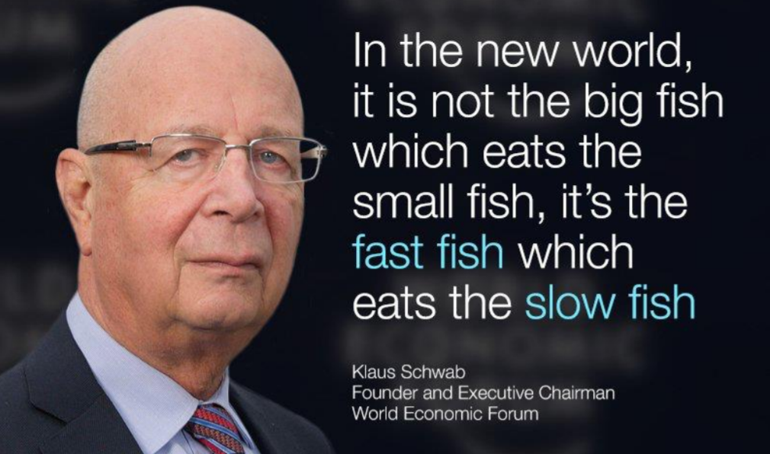

Slide 17
THANK YOU

