Slide 1


NIIT Compliance Passport
Running Mandatory Training Like a Business
Dylan Strokes

Slide 2




Key Compliance Challenges
Compliance as a culture
Compliance training resulting in changed behaviour
Learning exactly what you need to know and why it matters
Relevance
Engagement
Increased engagement reduces compliance misconduct by 13% and increases self-reporting by 20%.
Learning for your current role
Learning without time away from work
Lack of regulatory understanding resulting in increased regulatory sanctions
Seat Time
Impact

Slide 3





NIIT Compliance Passport App
Role-based training to increase relevance, reduce seat time and enhance engagement
Mobile-ready
Impact: Higher level of regulatory understanding, aimed at reducing regulatory sanctions
Market experts review regulatory changes and provide guidance via the Workflow tool

Slide 4
NIIT Compliance Passport App – Objectives
Objectives:
To provide continuous compliance training to the entire workforce through their employment life cycle
To make compliance training engaging, accessible, live and easily understandable
To provide role-based compliance training with short seat time
Scope:
NIIT Compliance Passport will cover legal and regulatory compliance.
It will not cover internal compliance for corporates, such as loan/ credit policy.

Slide 5

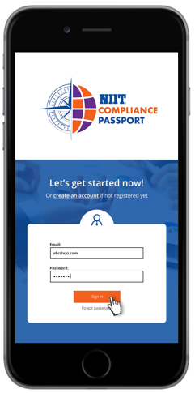
NIIT Compliance Passport - Components
Desktop Component
Mobile Component
Workflow tool for Corporate compliance, business and infrastructure stakeholders. This includes regulatory updates and dashboards.
Mobile App for Compliance training and News to employees
¹This will be hosted on NIIT cloud platform. Alternatively can be hosted on customer’s cloud, if requested.

Slide 6


NIIT Compliance Passport App - Channels
Training
News
Regulatory
Updates
Engaging learning nuggets on NIIT Compliance Passport App
Behavior-based learning
Role-based learning
Efficient New Hire mandatory training
Refresher mandatory training on anniversary
Daily news on NIIT Compliance Passport App
Regulatory and Market News
  Regulator trends and fines
  Market events i.e. AML or Cyber Security Breach
  Focus on impact and prevention
Internal commentary from Corporate Compliance teams can be distributed by the App
Analysis and advice available on NIIT Compliance Passport app
Analysis of regulatory guidelines by market experts
  New actions pushed to the app
  Status of own actions published for each stakeholder
  Reminders from tool by e-mail and on App

Slide 7

NIIT Compliance Workflow Tool
NIIT Compliance Passport Workflow Tool will provide:
Analysis of regulatory guidelines by market experts
Advice reviewed by internal compliance and stakeholders
Status of all actions tracked in the tool
If you subscribe to the workflow tool, you have additional benefits:
Due to regulatory updates, notifications and the status of actions will be pushed to the NIIT Compliance Passport app.

Slide 8




NIIT Compliance Workflow Tool
New regulatory update
Trigger
All Users
These feed into the NIIT Compliance Workflow tool
Analysis appears on the workflow tool, accessible to corporate compliance team
Workflow tool sends new actions and reminders to stakeholders
NIIT
Professional compliance officers create analysis and recommendations
If the regulatory change
is worthy of news, update is sent to all app users
Seek
validation
approved
Compliance reviews the analysis and agrees or amends the action(s), and due date
Sends to relevant Stakeholders
Compliance validates feedback from Stakeholders and agrees or amends the action(s), relevant stakeholder(s) and due date
Compliance
Seek
validation
approved
Stakeholders validates the analysis and agrees or amends the action(s), relevant stakeholder(s) and due date
Sends approved version to Compliance
Stakeholder
Comply/Certify
Stakeholder updates the progress of the action until completion

Slide 9




Learner Journey
Bank employee
On joining the bank
At Anniversary
When Regulation
is released
Ongoing
Install the NIIT Compliance Passport app to study:
  KYC guidelines
  Information Security
  Anti money laundering
  Ethics and Conduct
Re-certify on the following courses:
  Information security
  Ethics and conduct
  Anti money laundering
News update/action
Certification (as required)
Role-specific courses
  Risk Management
  Financial statements
  Treasury Management
  Foreign exchange
  operations
40-60 minutes
30 minutes
15-20 minutes per month

Slide 10

Training
HR shares employee names and roles
Bank
approved
approved
NIIT creates a database on Cloud platform and maps roles to names
Analysis appears on the workflow tool, accessible to corporate compliance team
NIIT creates milestone-based assessments
NIIT
Learners install the app during Induction (sign in using SSO)
Compliance validates feedback from Stakeholders and agrees or amends the action(s), relevant stakeholder(s) and due date
Refresher training Access to past training
View self progress in a dashboard
Assessments and Ebadging on completion of specified levels of training
Compliance Passport App

Slide 11
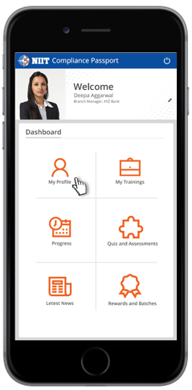


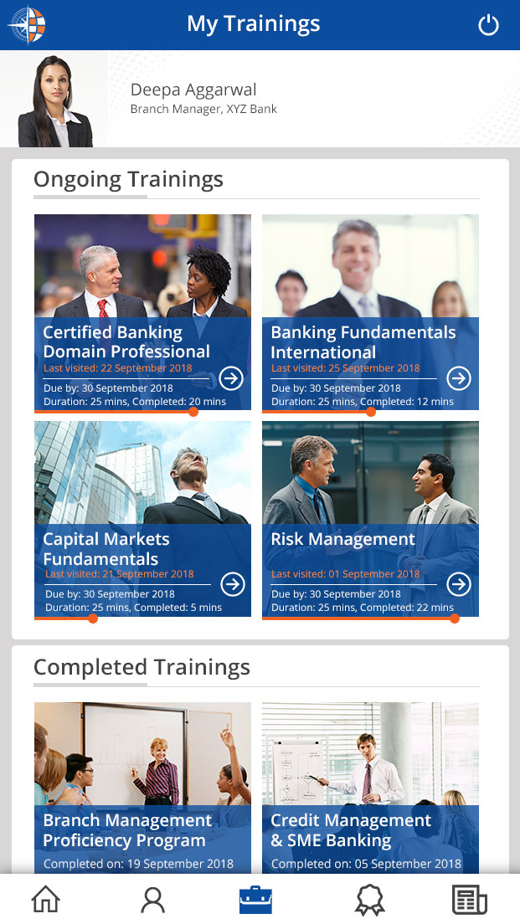
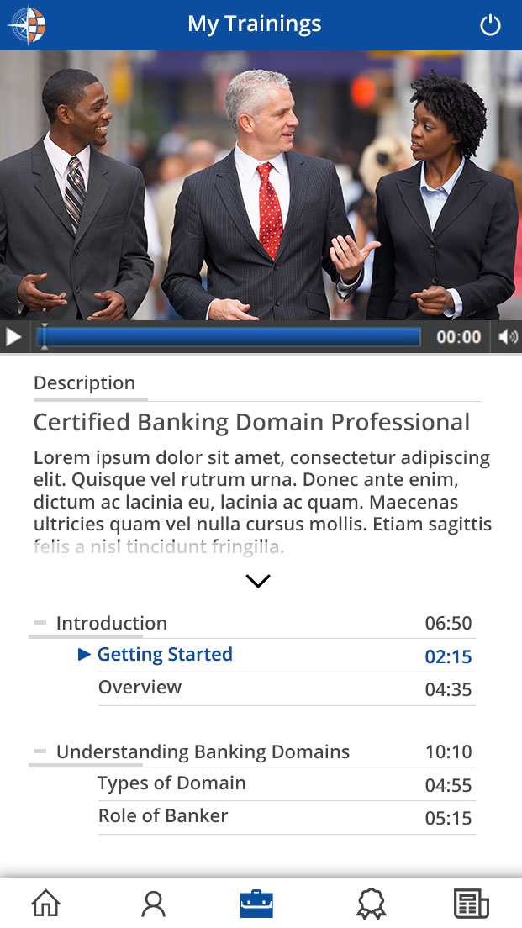
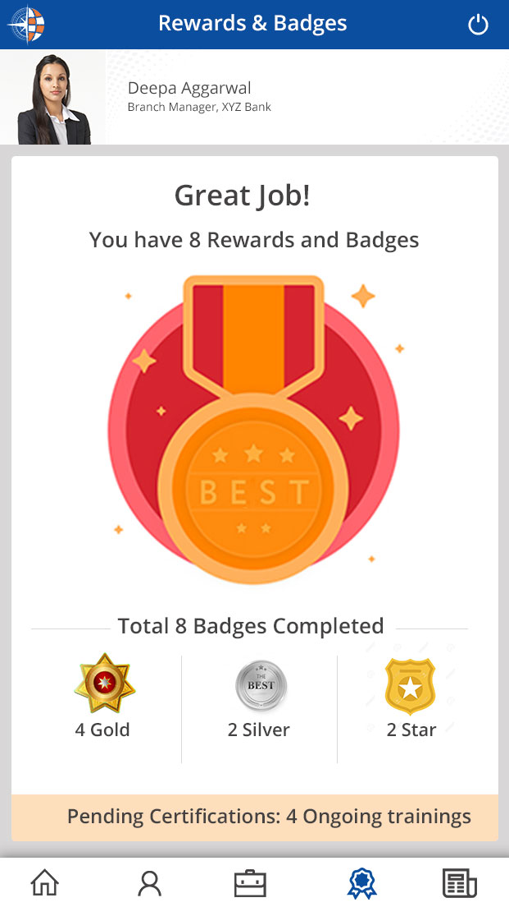
Sample NIIT Compliance Passport App

Slide 12





News
Learning time – 10 to 20 seconds
News is broadcast to everyone who has installed the app
NIIT Market experts/ professional compliance officers monitor news and Websites constantly
NIIT Compliance officer writes 3 things about the news:
What happened
What’s the impact
What we need to do in future
Copy edit the writeup
NIIT Production team pushes 3 things to the app
Link to read the full story

Slide 13
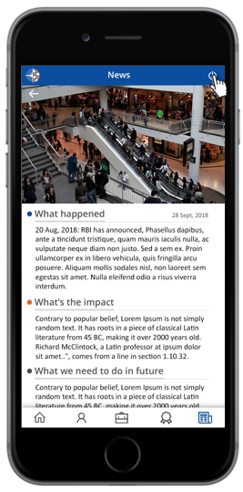

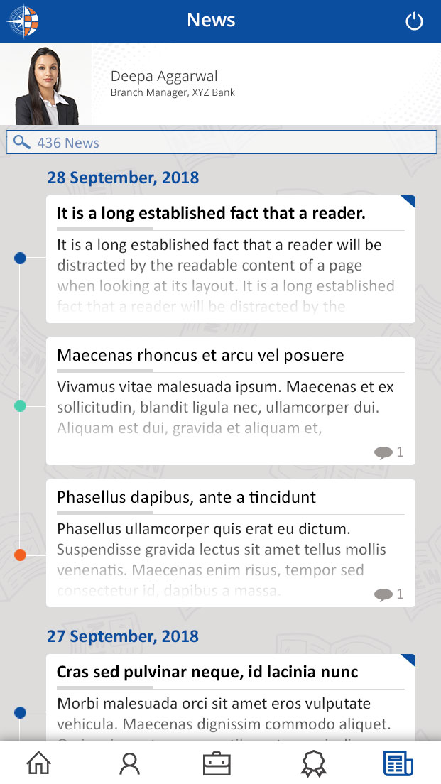
Sample News Screens
Search feature in News (by date, by topic)
For past news show a link to Company’s response to this news.

Slide 14
Feature List – NIIT Compliance Passport App
Vital
Required
Desired
Release 1 of the app will have:
Three channels active – Training, News, Regulatory updates
New joiner training content (listed on the next slide)
Learner dashboard that shows certificates about to expire, certificates or activities pending for role.
Search feature in News (by date, by topic), link to Company’s response to the news.
Release 2 will have:
Role-wise training courses
Behavior-based courses
User controls over videos (pause, play slide)
Assessments and e-badging
Tracking- course last visited, time spent on each course
Future releases:
For the learner – On Demand courses
For Compliance officer – detailed dashboards

Slide 15
Feature List – Workflow Tool
Vital
Required
Desired
Release 1 of the Workflow tool will have:
Notification and trigger features for Compliance and Stakeholders on:
Reminders of pending actions at validation stage
Reminders based on due date of an assigned action
Release 2 will have:
View for Compliance - all actions in validation stage and action stage (not started, on track, overdue and complete)
View for Stakeholders - all pending validations and actions assigned to them (not started, on track, overdue and complete)
Future releases:
Badge system to be included in the NIIT Compliance Passport App based on completion of actions
Ability to update actions from the NIIT Compliance Passport App

Slide 16
Base Content in the NIIT Compliance Passport App
Know your customer (KYC) guidelines
Anti Money Laundering
Policy definition
Key elements of the policy
Customer Acceptance policy
Customer Identification Procedures
KYC for new accounts – process and precautions
Customer profiling and risk categorization
FATCA and KYC renewal requirements
KYC for zero balance accounts
Extra precautions in respect of certain categories
Three layers: Placement, Layering and integration
Prevention Of Money Laundering Act
RBI guidelines
Financial Intelligence Unit- Role and functions
Financial Action Task Force
Cash transactions and suspicious transactions
Software for screening, parameters for screening and adequacy
Monitoring and reporting of transactions
Nature and format of reporting
Trade based Money Laundering
Correspondent banking and Exchange companies relationship
Information security
Policy and Impact of breach
Good practices of Information security
Ethics and conduct
Customer Service Fair Practices
Fair Practices code
Citizens charter
BCSBI Code
Banking Ombudsman Scheme
Reporting and Disclosures
Service rules
Prevention of corruption Act
Code of conduct in oral and written communication
Insider trading
Code of conduct for board members

Slide 17
Subscription Model
Training
Regulatory
Updates
News
Banks can subscribe to one or more channels for the app.

Slide 18

How Do We Begin?
Co-design with Customers
Build
Implement
NIIT’s Compliance Passport will leverage over a 100 Years of Mandatory Training Experience.

Slide 19









The Team Composition
CUSTOMER
External:
NIIT
Bank stakeholders
Compliance experts
IT/ Systems team
Bank’s Compliance Officer
Voice support team
Content Design team
End users

Slide 20

COURSE LIST

Slide 21

Course List
ANTI-MONEY LAUNDERING
Anti-Money Laundering
Sanctions
Anti-Bribery & Corruption
OPERATIONAL RISK & INFORMATION RISK
Operational Risk Management
Data Privacy & Record Management
Cyber Security
Information Security
Electronic Communications

Slide 22
Course List
COMPLIANCE
Code of Conduct & Ethics
Annual Self-Certification
Insider Trading / Conflicts of Interest
Personal Compliance (Outside Business Interests & Personal Account Dealing)
Robbery Prevention Awareness
Competition Law

Slide 23
Course List
COMPLIANCE - US
Annual Securities Training (FINRA) – Firm element
Real Estate Settlement Procedures Act
Health Insurance Portability and Accountability Act (HIPAA)
SAFE Act
Federal Housing Act
Bank Secrecy Act
Flood Insurance Training
Reg C to W Training
  Home Mortgage Disclosure Act (HMDA) – Reg C
  Reg P & Gramm Leach Bliley Act
Americans with Disabilities Act
Affiliate Transactions

Slide 24
Course List
COMPLIANCE - CANADA
Canadian Consumer Protection – Financial Consumer Agency of Canada
Canada’s Anti-Spam Legislation (CASL)
Volcker

Slide 25
Course List
HR / BCM / HEALTH & SAFETY TRAINING
Inclusion & Diversity in the workplace
Health & Safety
BCM
Accessibility in the workplace
Preventing sexual harassment
Preventing workplace violence
Preventing discrimination and harassment
Serving customers with disabilities

Slide 26


